Slide 1
The Renaissance
Ch 12 Section 1

Slide 2
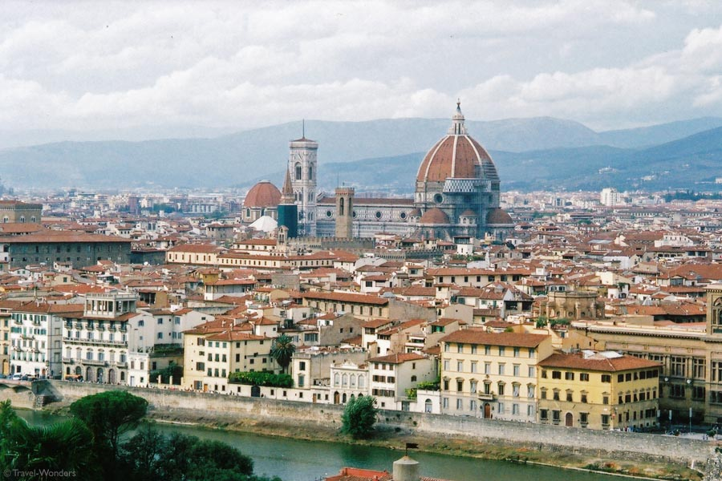
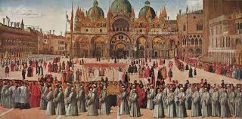
The Italian Renaissance
Renaissance = “Rebirth”
1350-1600
Growth of Cities led to Growth in power
City-States
Movement from Religion to secular view point
New Individualism
“Men can do all things if they will”

Slide 3
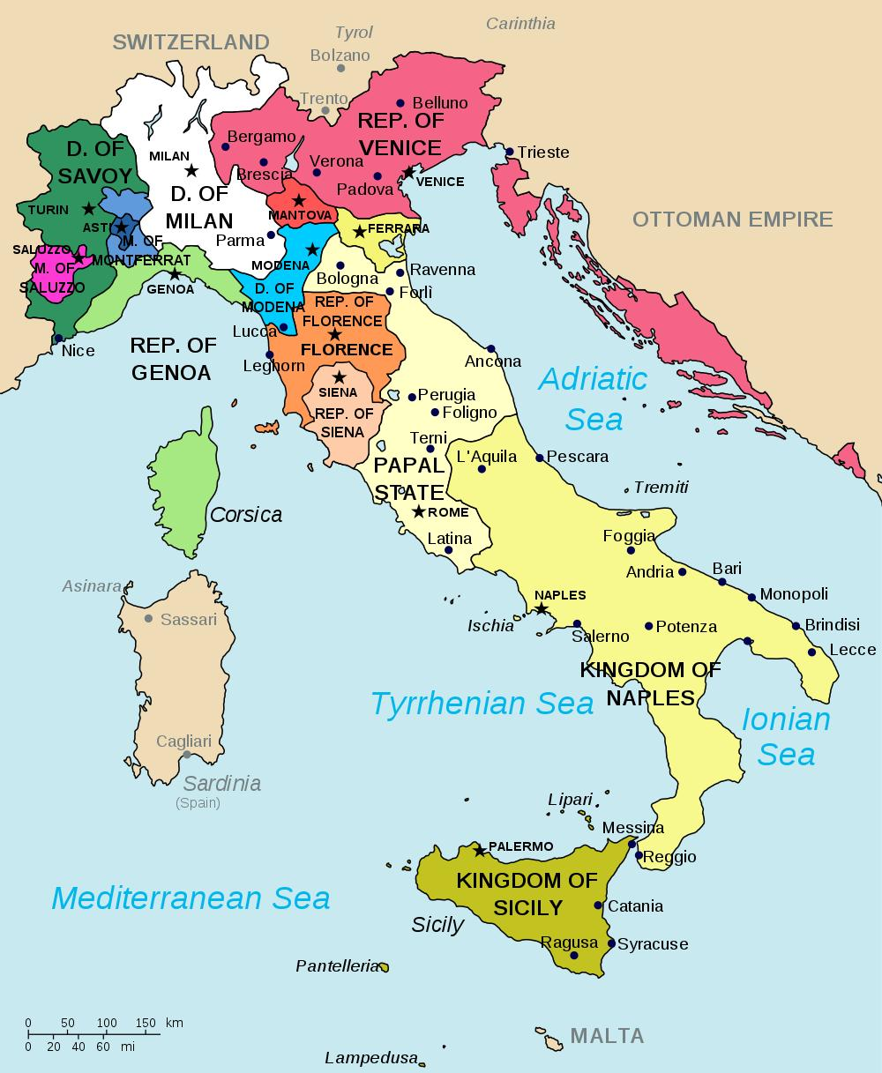
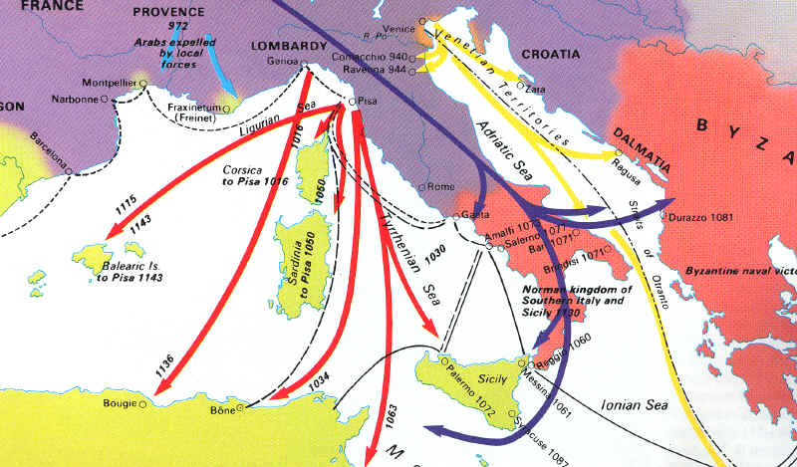
Italian City-States
Lack of Monarchy during Middle Ages
Milan; Venice; Florence; Rome
Trade with the Middle East allowed these City-States to prosper
Silk; Sugar; Spices
City States must battle each other for control of the trade Market

Slide 4
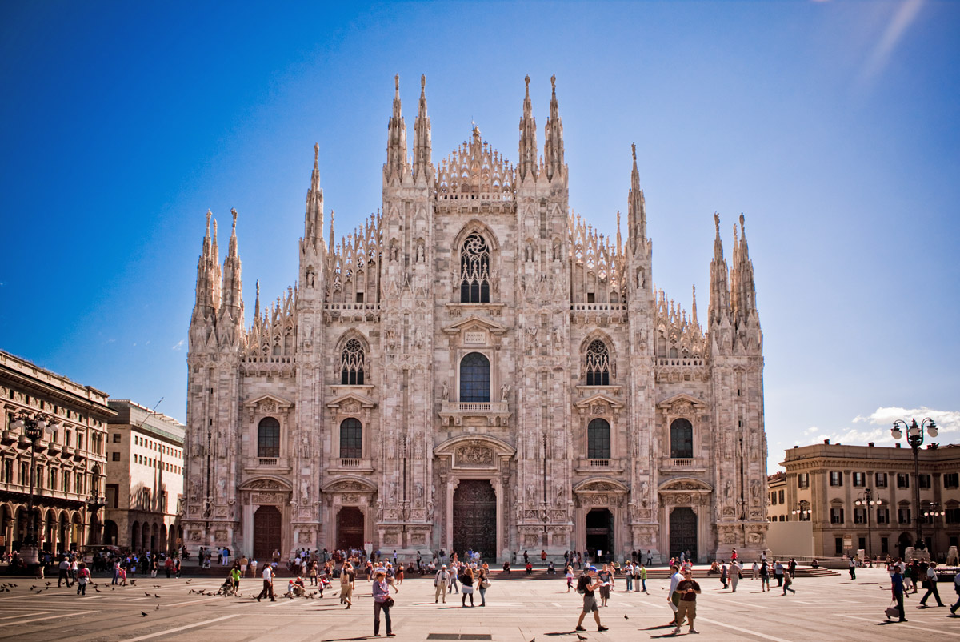
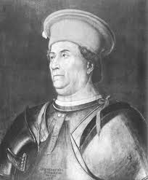
Milan
Francesco Sforza conquered Milan in 1447.
Controlled a band of mercenaries.
Built a large centralized state and efficient tax system.

Slide 5
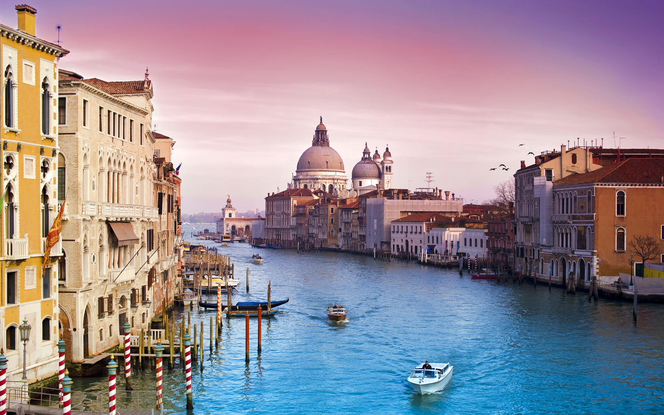
Venice
Link between Asia and Western Europe
Venice was ruled as a republic, with an elected official called a doge.
Wealthy merchants ran the government for their own benefit. (oligarchy)

Slide 6
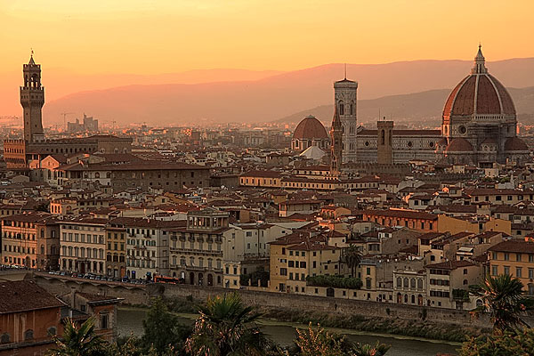
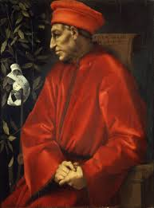
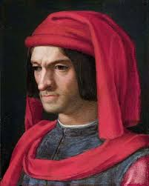
Florence
In 1434 the influential banker Cosimo de Medici took control of Florence.
Ruled the government from behind the scenes.
Used wealth to influence government officials.
Made Florence the economic center of Europe.
Lorenzo de Medici (The Magnificent), made Florence the cultural center of Italy.

Slide 7
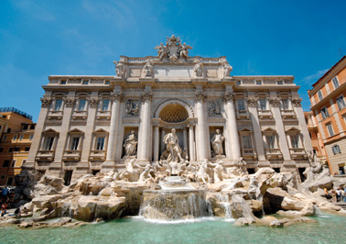
Rome
Rome, the capital of the Christian world, was ruled by the Papacy.
Pope Julius II, known as the “Warrior-Pope,” lead armies against neighboring city states.
Spent large amounts of money on building projects and artwork.

Slide 8
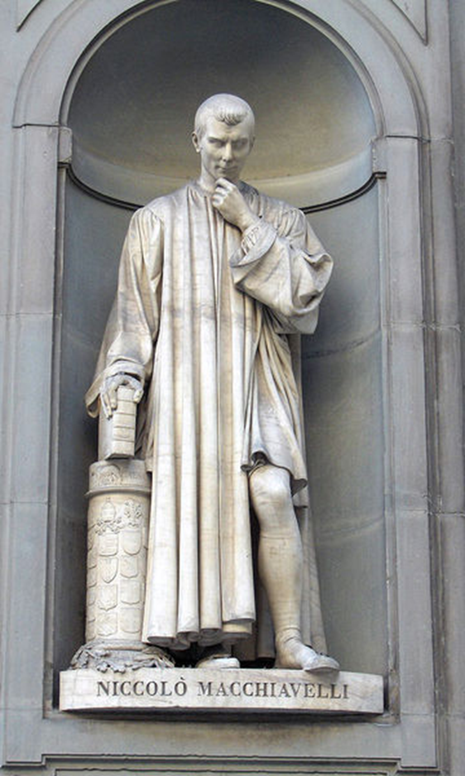
Niccolo Machiavelli
The Prince
Morality has no place in politics
The Ends Justifies the Means
“Although the best would be for the prince to be simultaneously love and feared, if only one could be chosen, fear would be the safer choice.”
“Those that are lazy in a way that does harm to the city, and who can offer no just reason for their condition, should either be forced to work or expelled from the city. The city would thus rid itself of that most harmful part of the poorest class.

