Slide 1
Early Civilizations of India
Chapter 3 Section 1

Slide 2
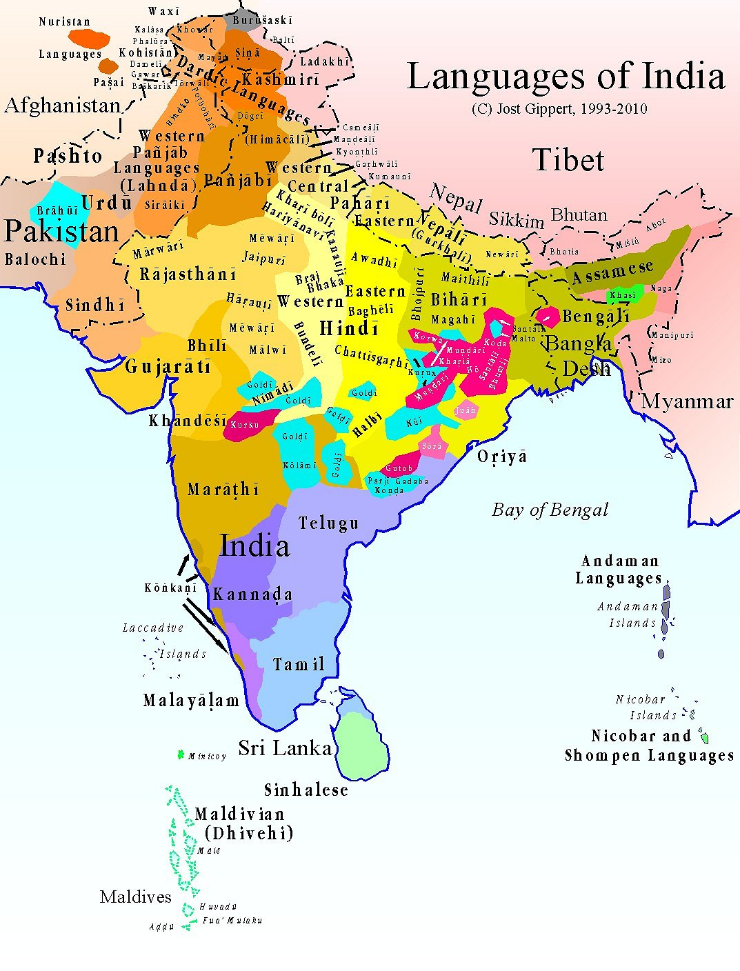
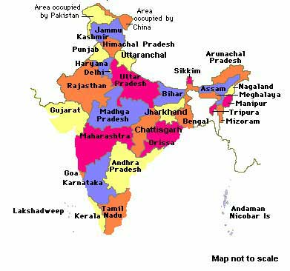
Language and Cultures
India is made up of many different cultures and more than 100 languages are currently spoke today.

Slide 3
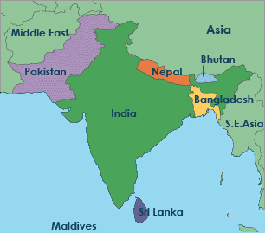
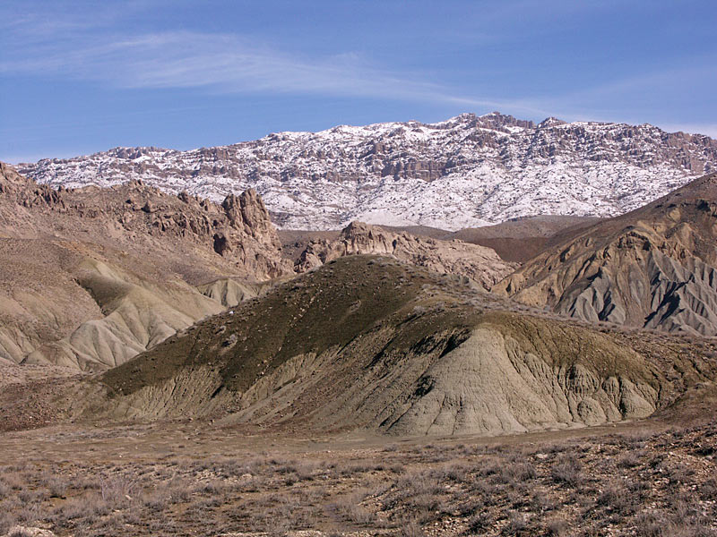
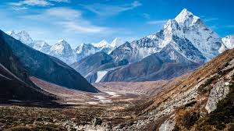
The Indian Subcontinent
Mountain ranges separate the peninsula from the rest of Asia.
How do you think this would affect the people who live there?
Hot and Humid Climate
Tropical Diseases
Throughout history conquering nations are slowed down and assimilated into the Indian culture.
Suleiman Range
Himalayas

Slide 4
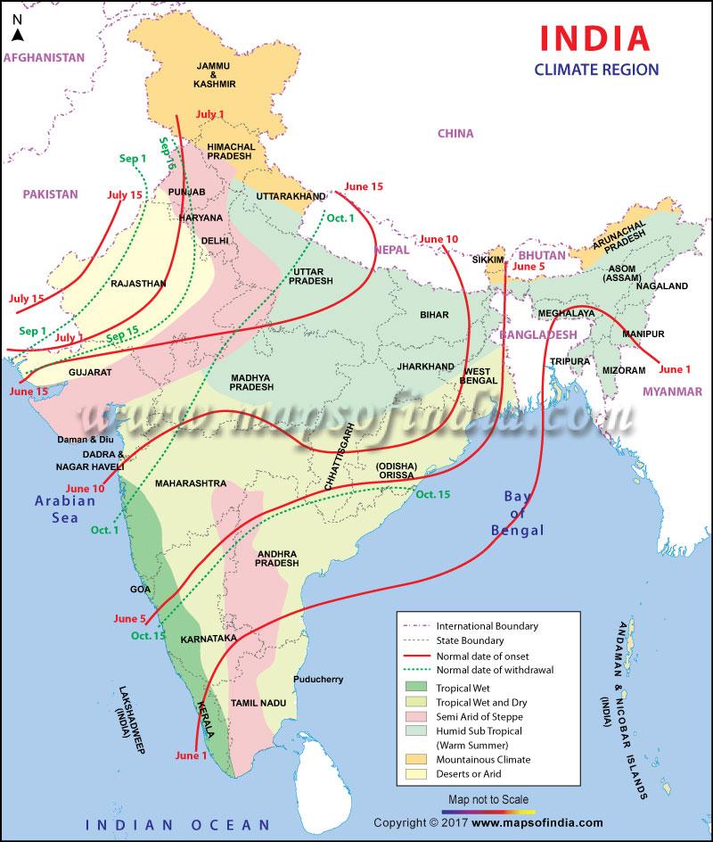
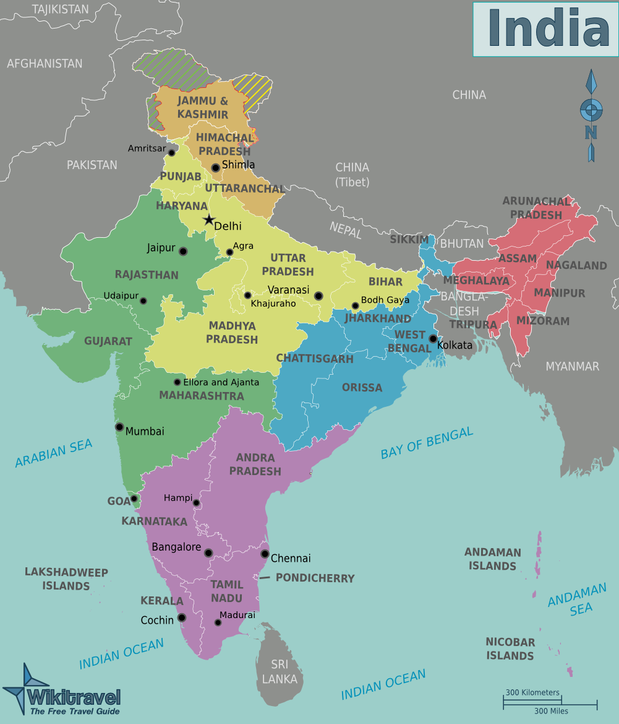
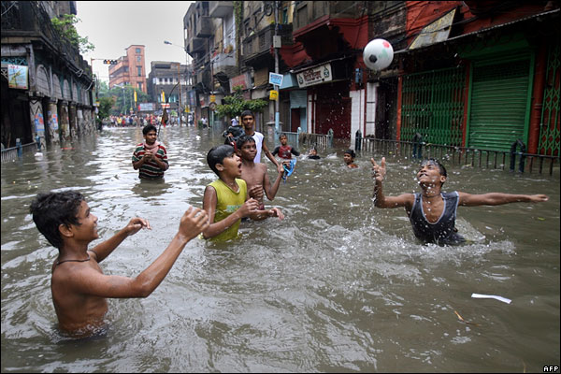
Regions and Weather
India is broken up into distinct regions
Monsoons
Summer and Winter

Slide 5
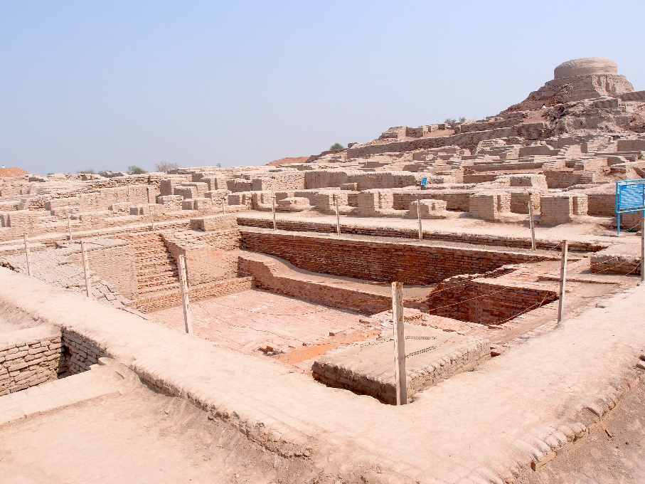
Indus Valley Civilizations
Artifacts Found
Communal Baths
Store House for Grain
Heavily Fortified Walls
Grid like system of roads and homes
Advanced drainage systems
Homes made of replicated baked bricks
Standardized weights and measures
Artifacts Not Found
Any evidence of monumental structures
Any evidence of temples, kings, armies, or priests.
Concrete evidence of religion (Seemed to idolize mother nature)
Writing that can be interpreted

Slide 6
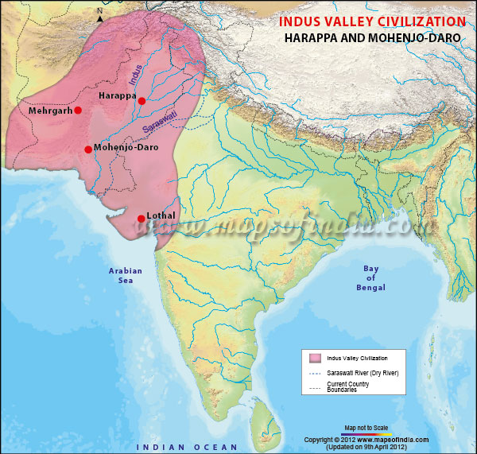
First Civilizations
Indus River Valley
3000BCE-1500BCE
Harappa and Mohenjo Daro
Advanced civilizations
Area is suddenly abandoned around 1800BCE

Slide 7
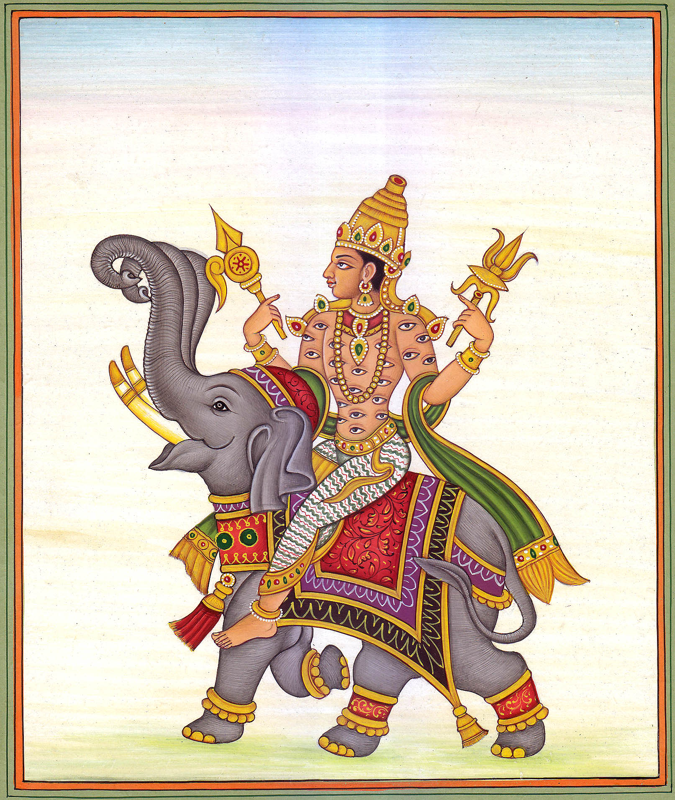
Aryans
1500-500 BCE
Nomadic Warrior tribe
Came out of Eastern Europe and moved through the Middle East and into the Indus Valley Region
Indra- King God of the Aryans

Slide 8
Aryans
Writing- Sanskrit
Allowed them to record legends and religious rituals
Social Structure
Believed Society was divided into four varnas (social Groups)
Brahmins-Priests
Kshatriyas-Warriors
Vaisyas-Commoners
Sudras-Servants
Untouchables

Slide 9
Aryans
The Caste System
Eventually this social organization evolved into a caste system.
Born into your caste with no chance of ever leaving during your life.
Only through death and reincarnation could you move from one caste to another.

Slide 10
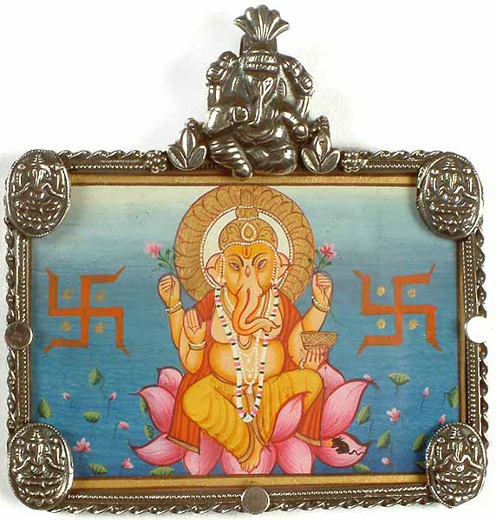
Nazis
Why would the Nazis use the term Aryan Race to describe their people thousands of years later?

