Slide 1
Indian Empires

Slide 2
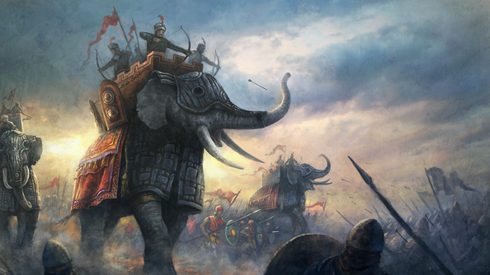
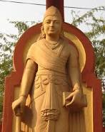
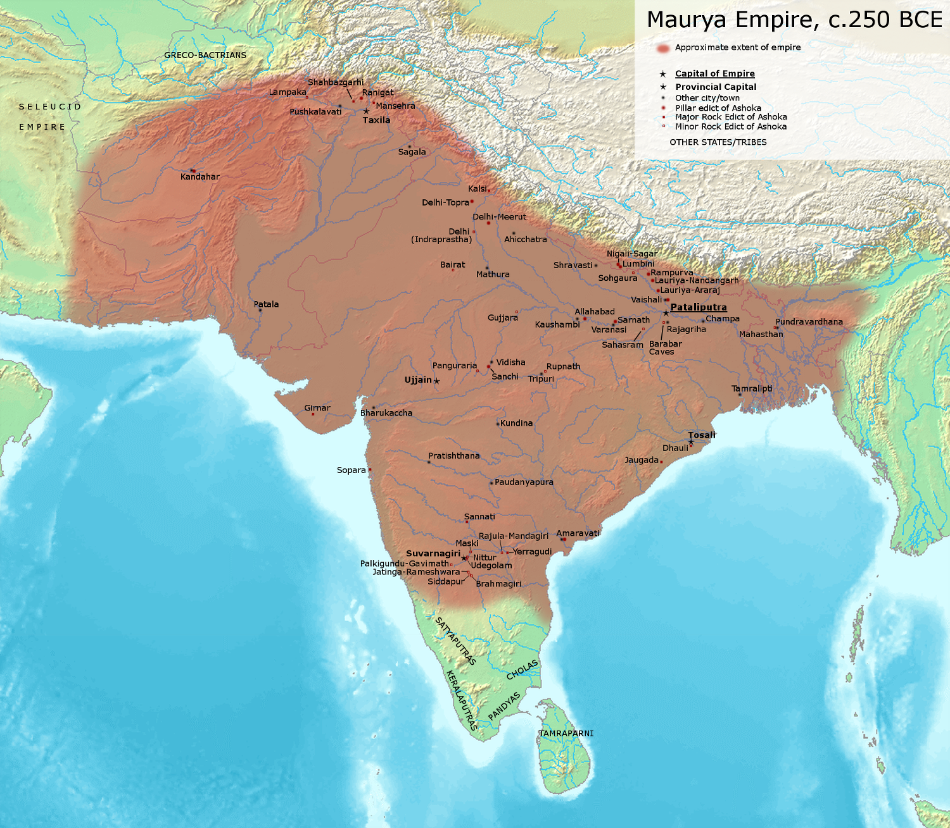
The Mauryan Empire 322-187 BCE
Chandragupta Maurya
Unites most of India under one rule
Creates the Mauryan empire
Asoka
Converts and spreads Buddhism throughout India

Slide 3
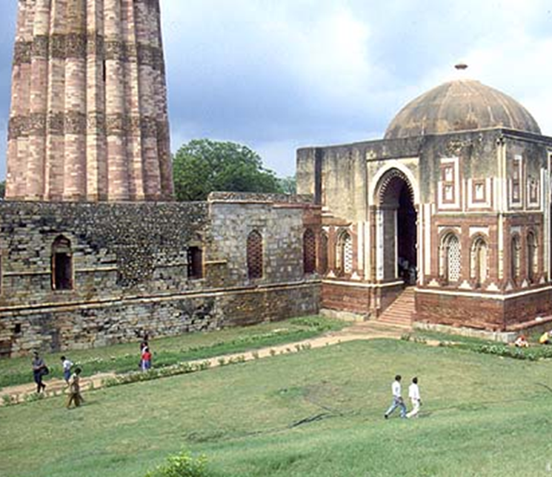
Mahmud of Ghazna
Invades from Middle East
Brings Islam to India around1000 AD

Slide 4
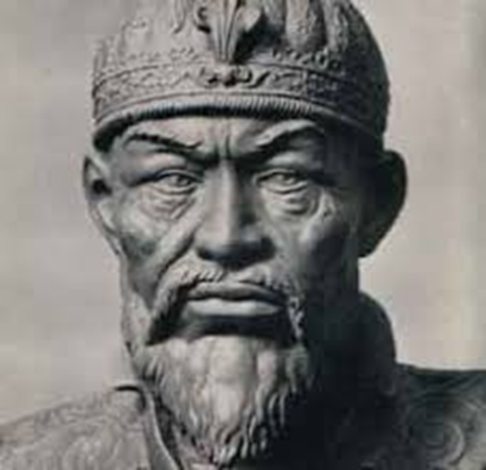
Timur Lenk 1336-1405
Mongol Tribe Leader
Invades northern India leaving it in ruins and open for conquering

Slide 5
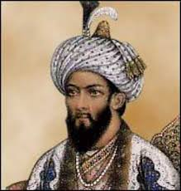
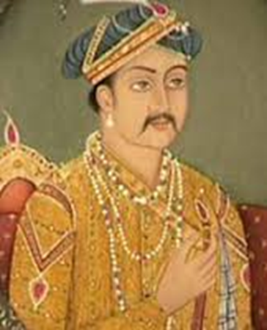
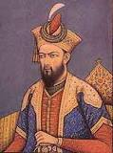
The Mughals 1526 - 1748
Babur 1483-1530
Muslim
Invaded from Middle East
Left Great works of Art – Taj Mahal
Intolerance of Aurangzeb led to hostilities between Muslims, Hindus, and Sikhs
Decline of Mughals leaves India open for the British.
NOT
Akbar - 1556 to 1605
NOT

Slide 6
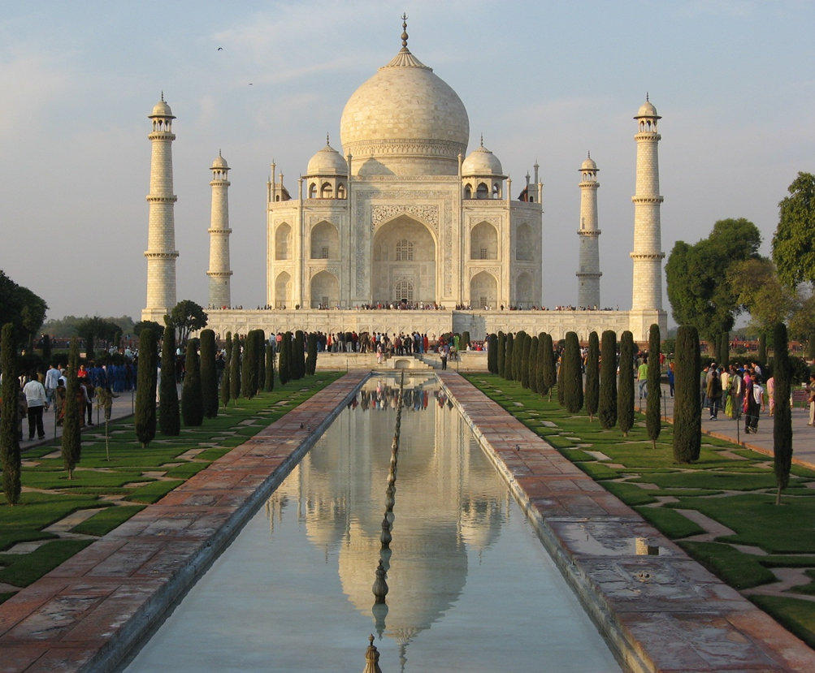
The Mughals
Shah Jahan
Built the Taj Mahal
Imprisoned by his son during the final years of his life
Decline of the Mughuls leaves India open for British colonization

