Slide 1
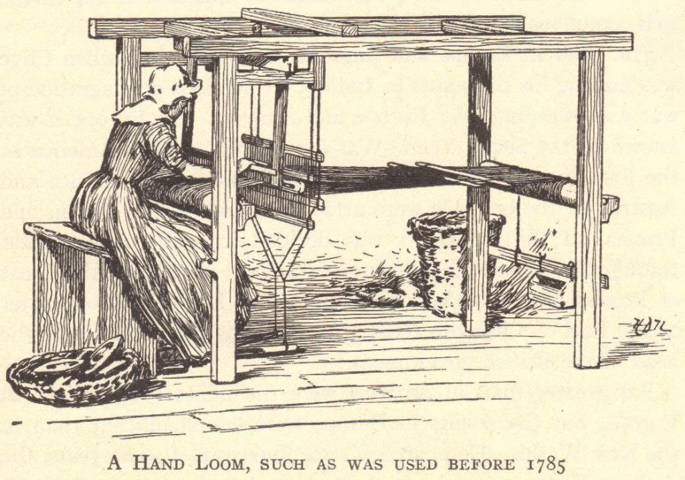
The Industrial Revolution
Ch. 19 Sec. 1

Slide 2
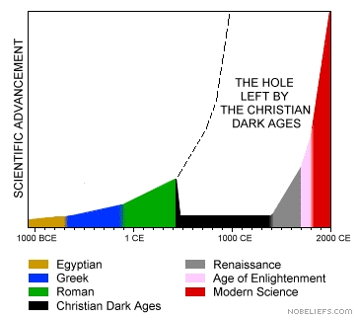
Significance of the Industrial Revolution
An ancient Greek or Roman (60BCE- 400CE) would have lived just as comfortably as a European in Europe in 1700
Daily life, agriculture and technology had not changed in 2000+ years

Slide 3
Great Britain
IR begins in in the 1780’s
Reasons
Better Weather; Better Transportation; New Crops (Potato) ➔ Increased Food ➔ Lower Food Prices ➔ Extra Spending Money
More Food ➔ Larger Population (Healthy people live longer) ➔ Larger Workforce
Excess Capital
Abundance of Natural Resources
Market (Colonies)

Slide 4
Growth of Industry
Coal Industry
Needed for steam engines
Iron Industry
Stronger metals means larger more advanced machines
Railroad Industry
Connected port towns to industrial centers
Railroads ➔ More jobs and cheaper goods ➔ New Markets ➔ More factories
Cottage System
individuals spun thread and wove cotton in rural cottages
New Inventions ➔ Workers move to Factories
Flying Shuttle
Spinning Jenny
Steam Engine
Factories no longer need a water source
Moved to Cities

Slide 5
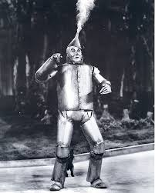
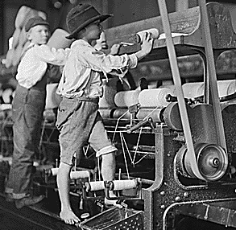
Down Sides
“… provided a child should be drowsy the overlooker walks around the room… and he touches the child on the shoulder, and says, ‘come here.’ In a corner of the room there is an iron cistern; it is filled with water; he takes this boy, and takes him up by the legs, and dips him over head in the cistern, and sends him to work for the remainder of the day”
Owners wanted to keep the machines running constantly
8am-8pm Dayshift
8pm-8am Nightshift
Workers were treated very poorly and disciplined severely
“the aim was to make the men into machines that cannot err”

Slide 6
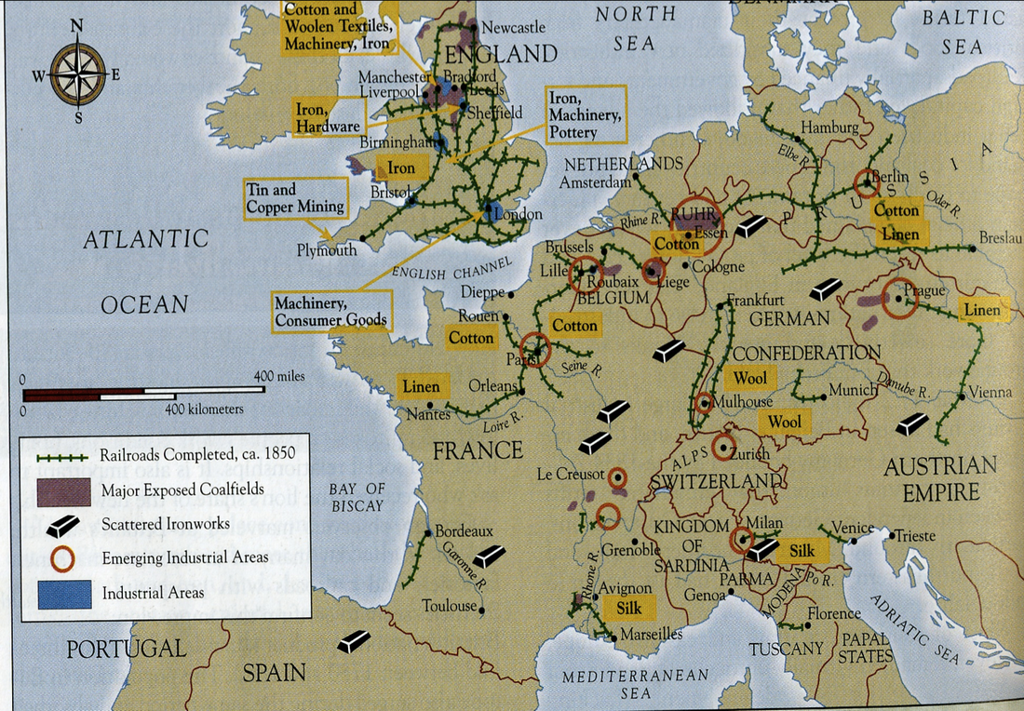
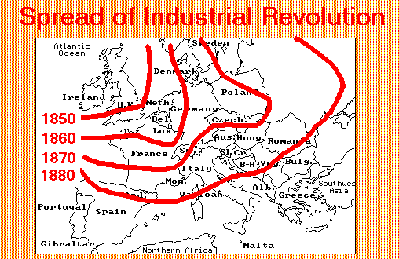
Europe
The IR continued to spread throughout the rest of Europe during the 1800’s

Slide 7
North America
Spread to the US during the 1880s and 1890s
Railroad industry flourished in the vast expanses of the United States

Slide 8
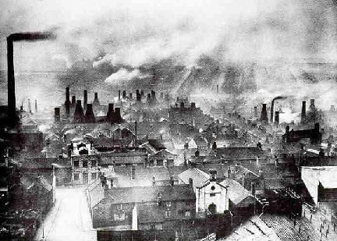
Urban Growth
Movement from rural to urban areas for jobs
Leads to increase in pollution and crowding

Slide 9
New Classes
Industrial Middle Class
Industrial Capitalism
Bourgeoisie
People who build factories, buy machines, and develop markets
Industrial Working Class- Prolateriate
Horrible working conditions
Very low salaries

Slide 10
Early Socialism
Called for better conditions for workers
Wanted wealth to be more evenly distributed
Karl Marx
Called for workers to unite against owners
Robert Owen
Utopian community where everything is shared

Slide 11
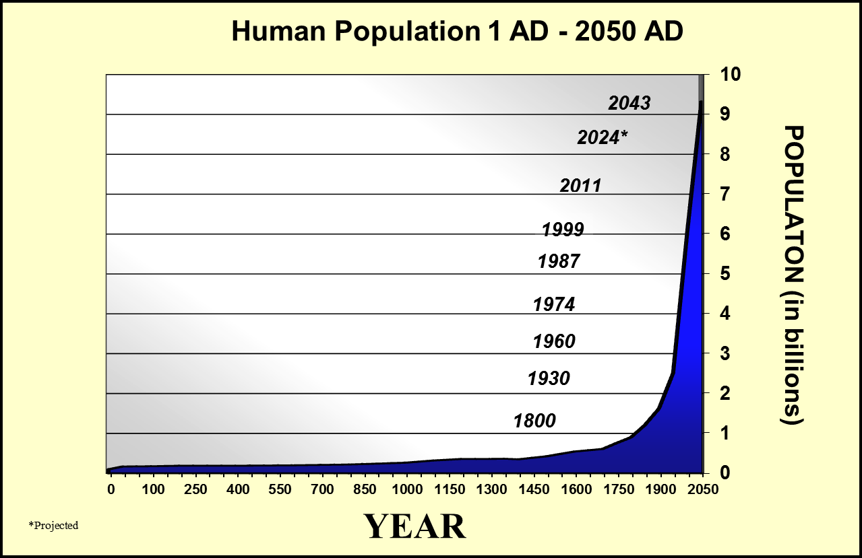
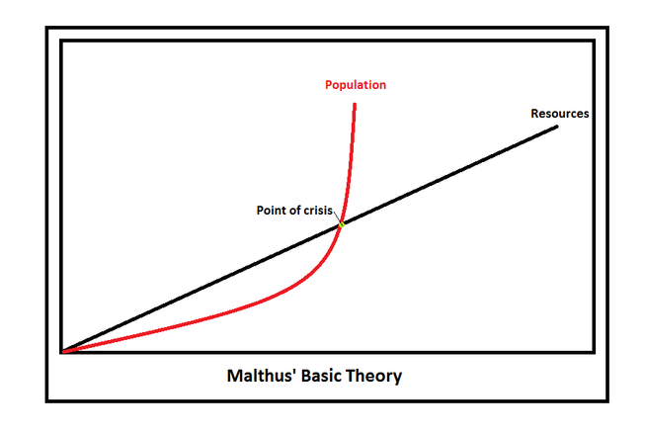
Population Growth
Better food = lower death rate
Thomas Malthus Principal of Population
Irish Potato Famine
10 Billion ?????????

