Slide 1
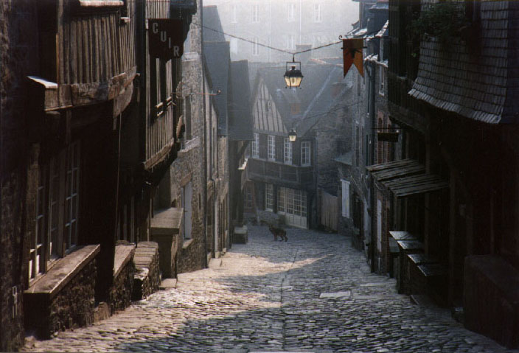
Peasants, Trade, and Cities
Ch. 10 Europe in the
Middle Ages
Ch. 10 Sec. 1

Slide 2
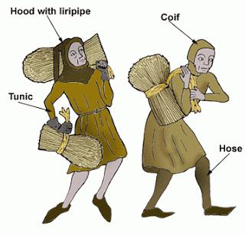
Peasants
Provide food and labor for the Knights
Played rent to farm the land.
Serfs = peasants legally bound to the land. (not slaves)

Slide 3
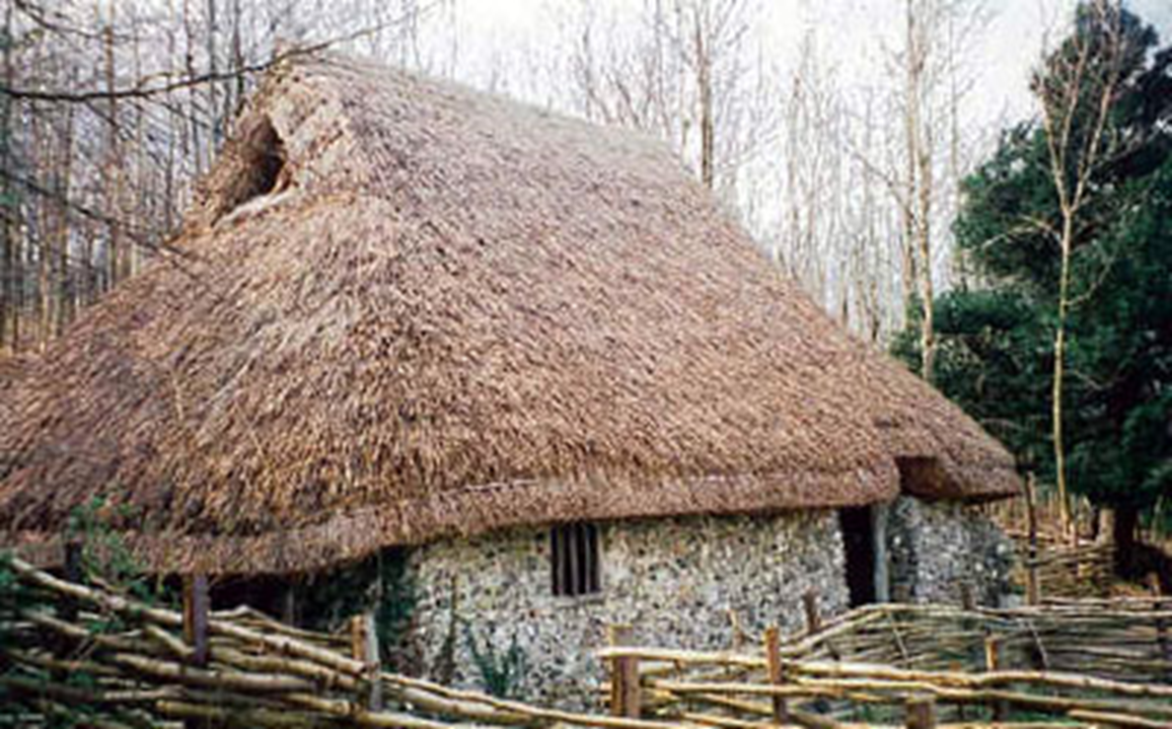
The Peasant Home

Slide 4
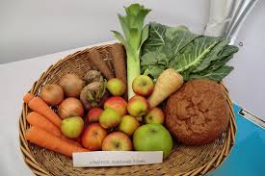
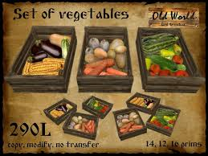
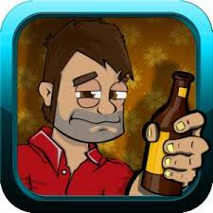
Peasant diet
Bread
Fruits (apples, pears & berries)
Dairy products
Meat - Only on holidays
Ale – 3 gallons/day

Slide 5
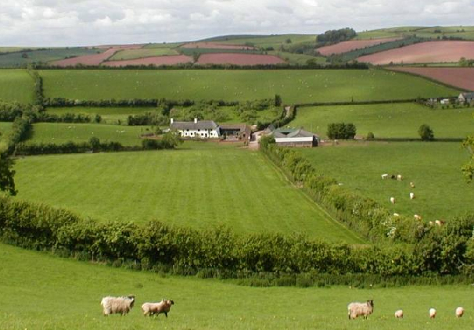
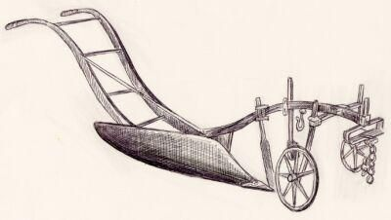
Agricultural Advances (1100-1300)
New Technology
Carruca (Iron)
Crop Rotation
Fallow

Slide 6
Cycle of Labor
Work year round
Holidays
Christmas; Easter; Pentecost
Sundays
Other Holidays

Slide 7
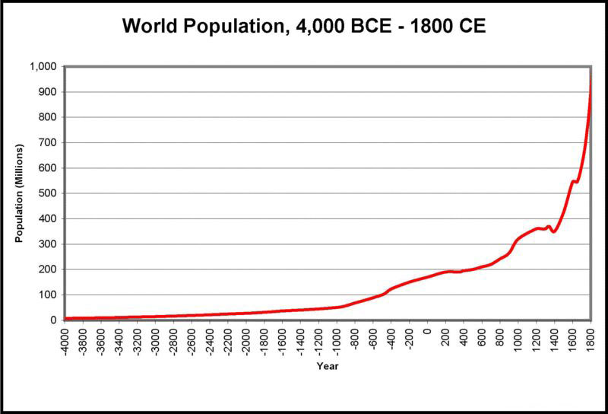
Population Growth
Climate Change
New Technologies

Slide 8
Effects of Population Growth
Growth in population >
Rise in labor force >
Ability to create a surplus of goods >
trading for other goods >
growth in population

Slide 9
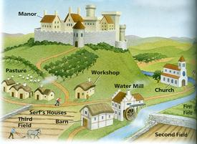
Manorial System

Slide 10
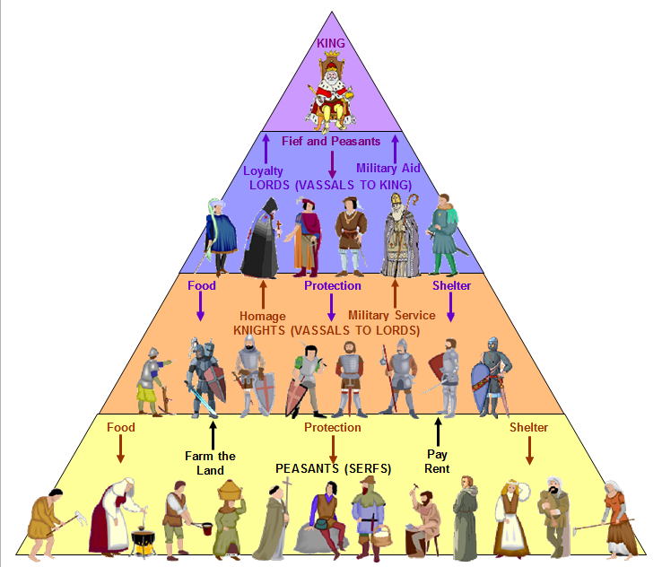
Feudal Hierarchy

Slide 11
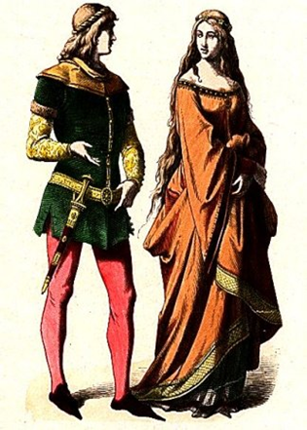
Nobles
Lived lives of luxury.
Given a Fief and Peasants by the King.
Provided protection for their peasants and knights.

Slide 12
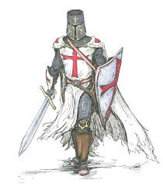
Knights
Spent their lives preparing for battle.
Tournaments
Squiring
Feudal Contract
Paid homage and provided military service to their Lord
Given Food, Shelter, and protection by their lord

Slide 13
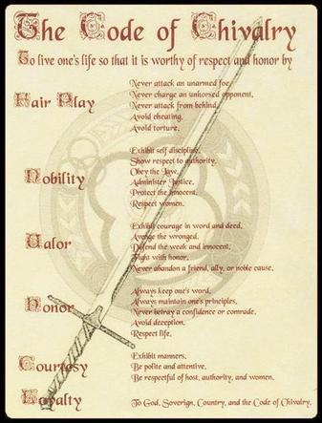
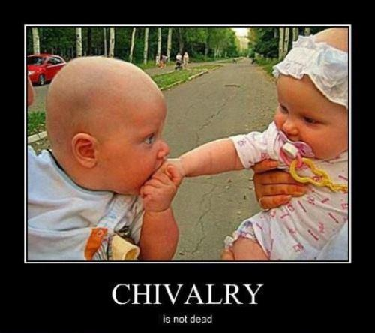
Chivalry

Slide 14
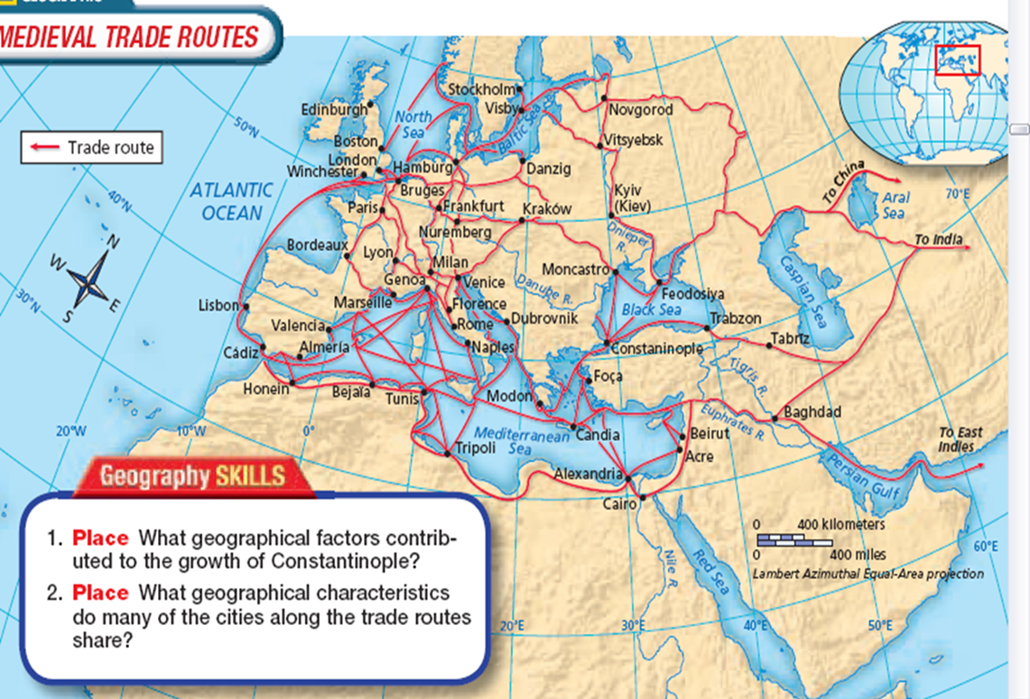
Growth of Towns and Cities
Merchants settled into towns and cities along trade routes
Venice/Flanders
Bourgeoisie/Burghers
Lived in the cities
New class of People
Merchants and Artisans
Barter => Money Economy
Patricians
Members of the wealthiest families
Replace nobles in the power structure of cities

Slide 15
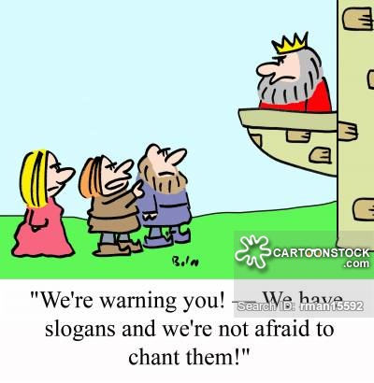
New Freedoms
Peasants began to demand new freedoms
Permission to visit trade centers
Freedom from military service

Slide 16
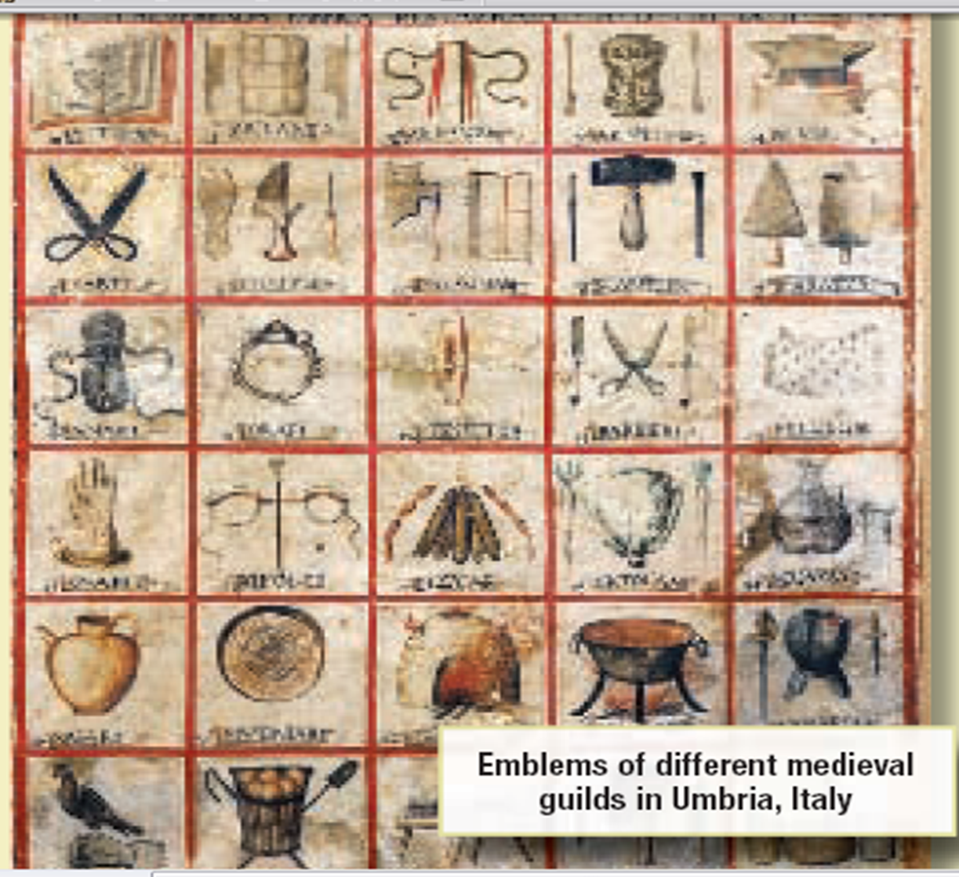
Industry and Guilds
Guilds
Trained people in a specific trade
Set standards for goods
Fixed Prices
Apprentice; Journeyman
Masterpiece

Slide 17
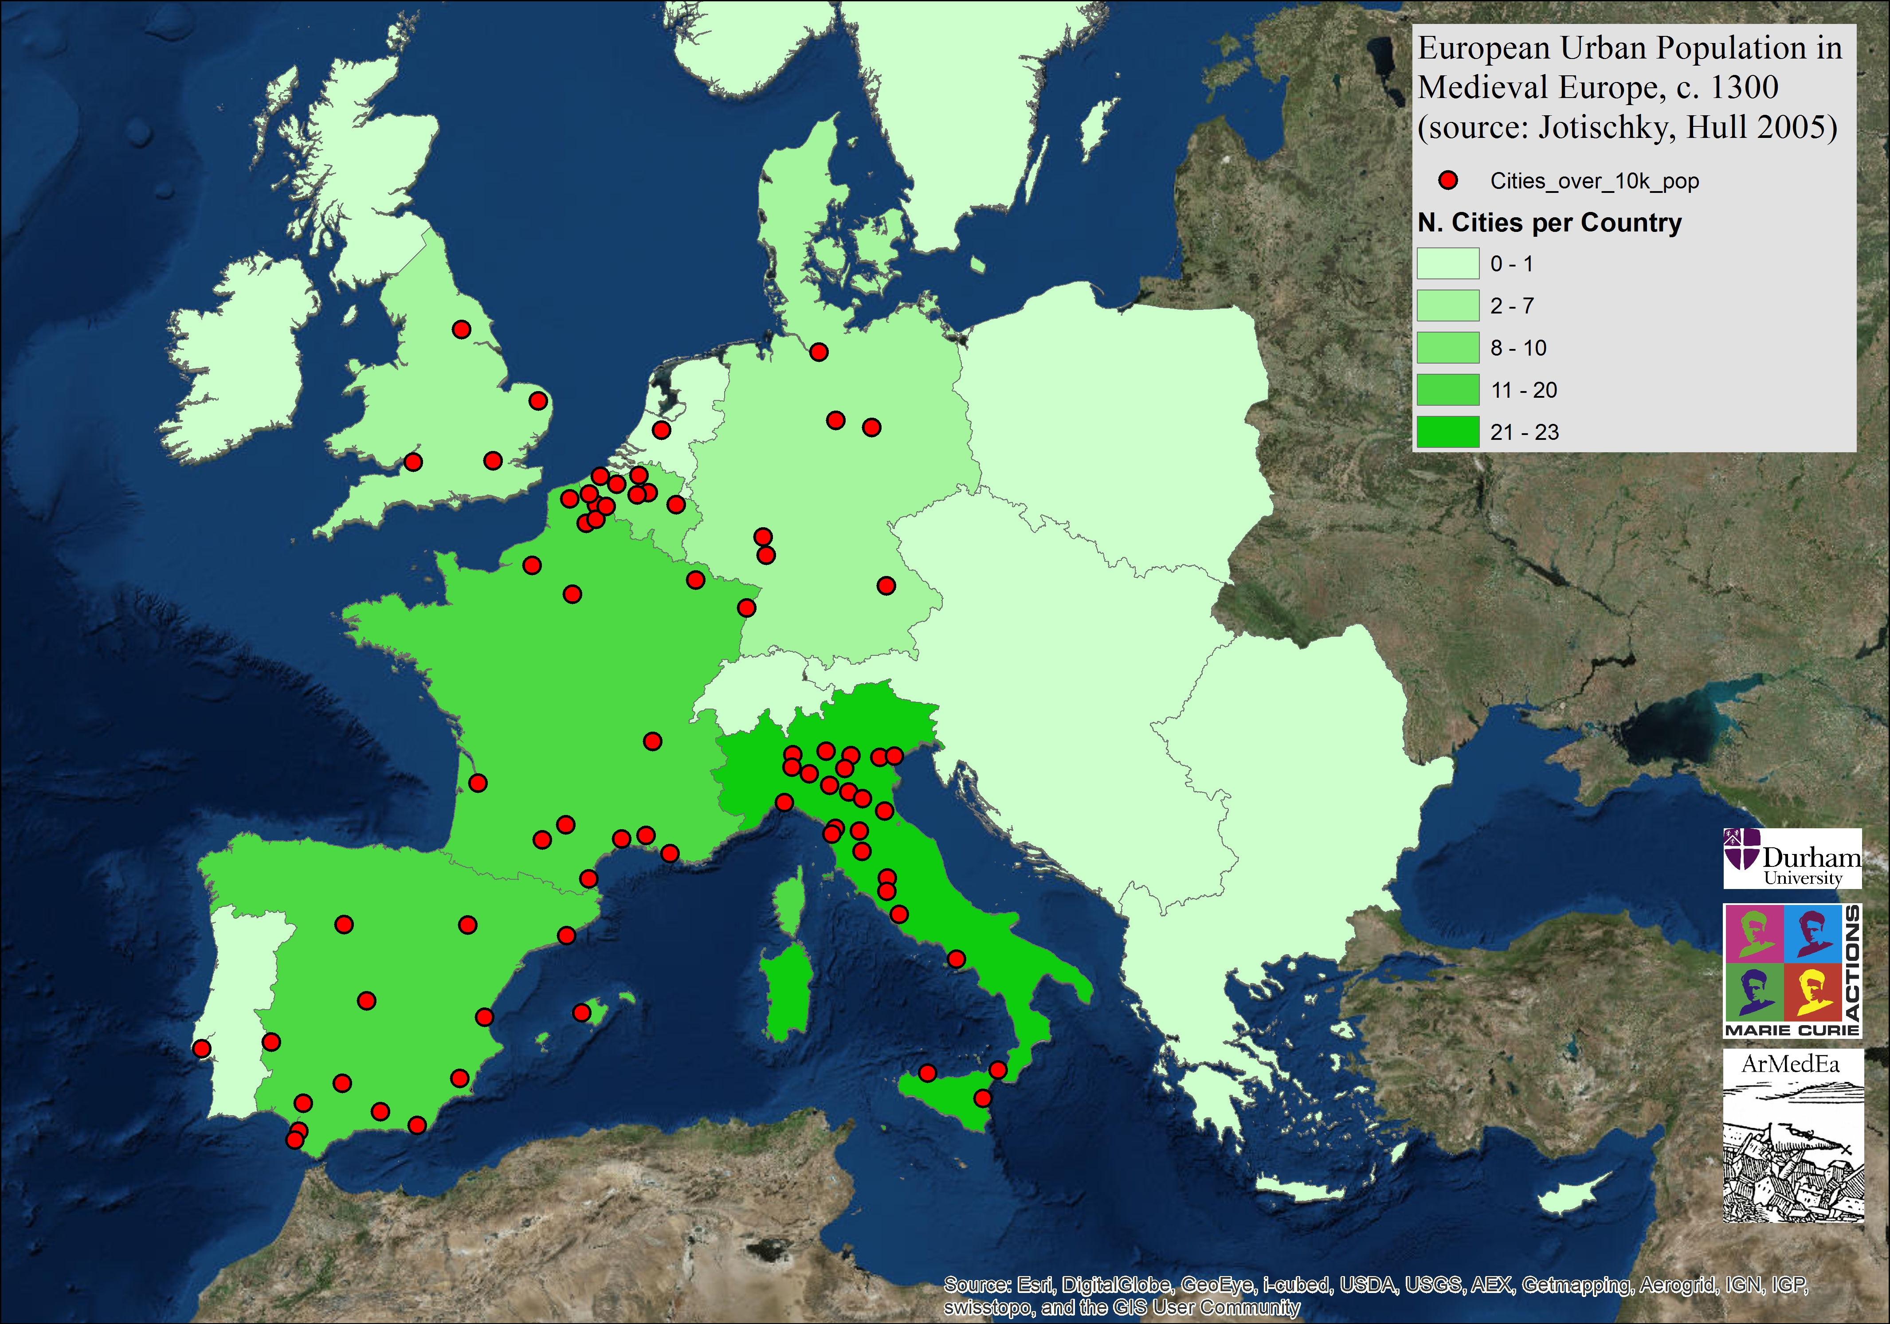
Population Shift

Slide 18
Medieval City

Slide 19
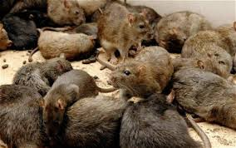
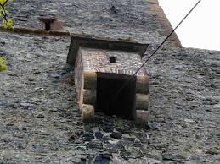
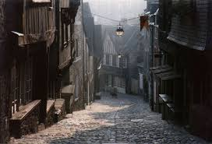
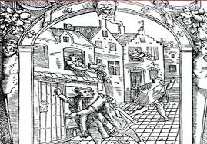
City Life
Dirty
Pollution

