Slide 1
Chapter 10 Section 2 & 3
Medieval Christianity and culture

Slide 2
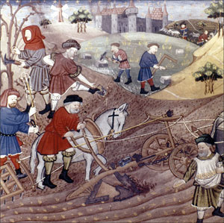
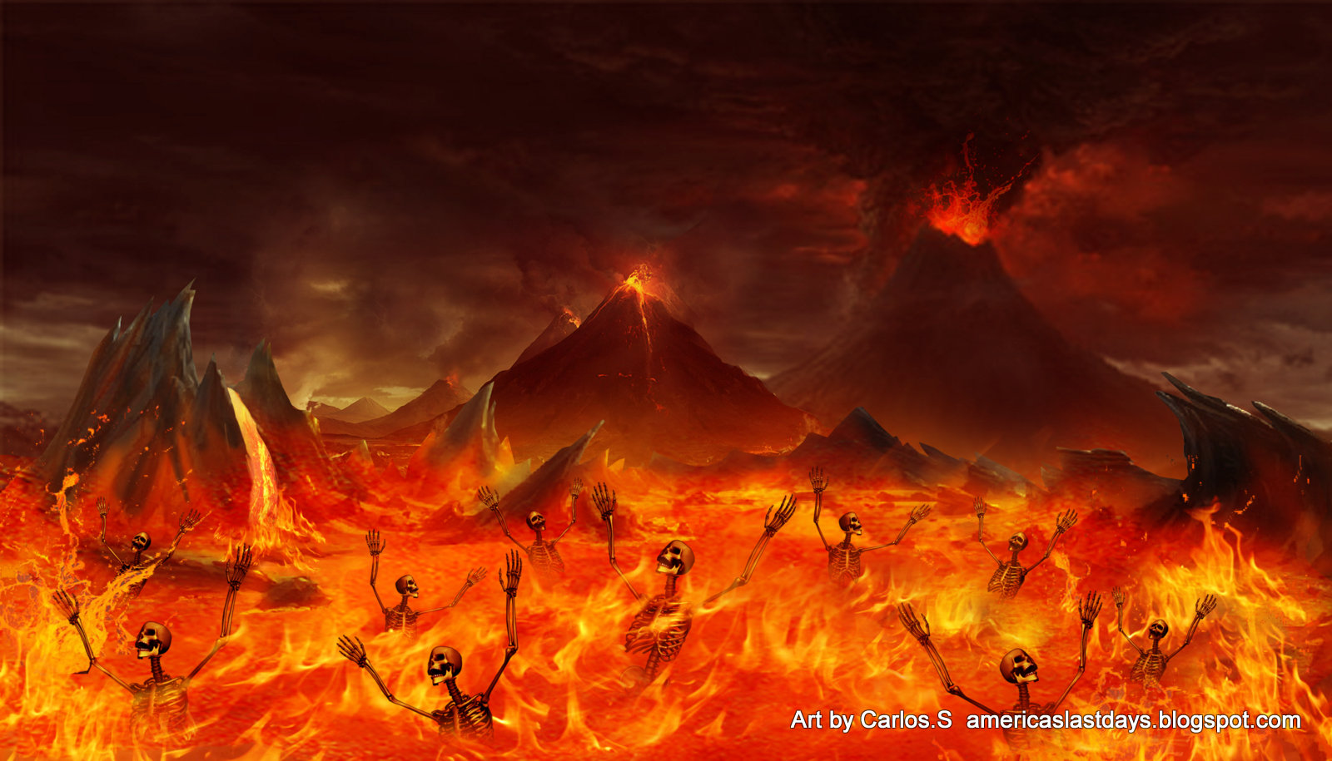
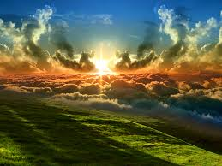
Why was Religion So Important?

Slide 3
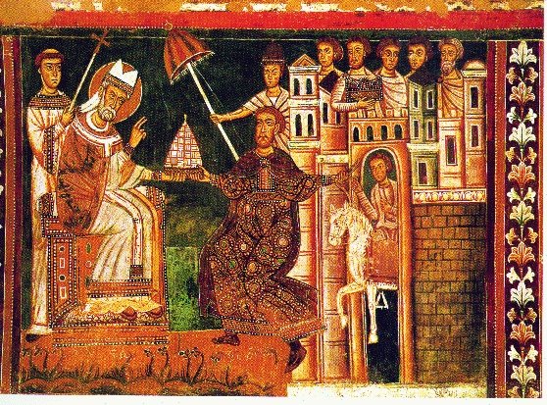
Religion in the middle ages
Most crucial part of daily life
Everything you did was governed by your faith
Food, clothing, language
Any breaking of church law resulted in excommunication and eternal damnation
The Pope=Vicar on Earth
Daily prayers to both god and the saints
Pilgrimage to holy shrines and lands
Crusades
First Crusade (1095–1099)
Second Crusade (1147–1149)
Third Crusade (1187–1192)
Fourth Crusade (1202–1204

Slide 4
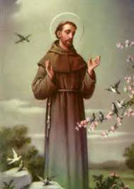
Strict Orders Emerge
Franciscans and Dominicans
Chasity
Silence
Solitude
Flagellation and self Penance

Slide 5
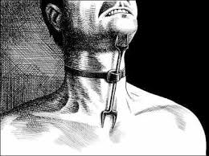
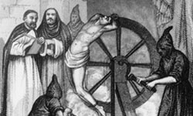
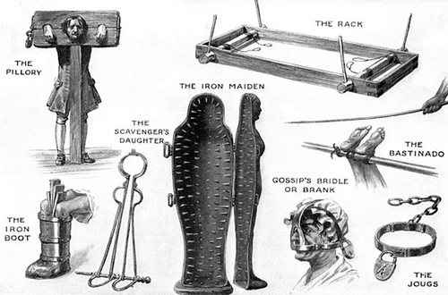
Inquisition
1252
A holy office created to stamp out heresy (the denial of basic church doctrines)
Used torture to extract confessions
Those who did not confess were tortured to death and were still considered guilty

Slide 6
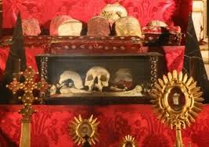
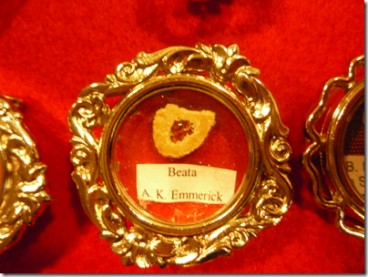
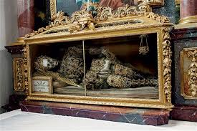
Religion in the High Middle Ages
Relics- Bones of saints or objects connected with saints
Worthy of worship
Connection to god

Slide 7
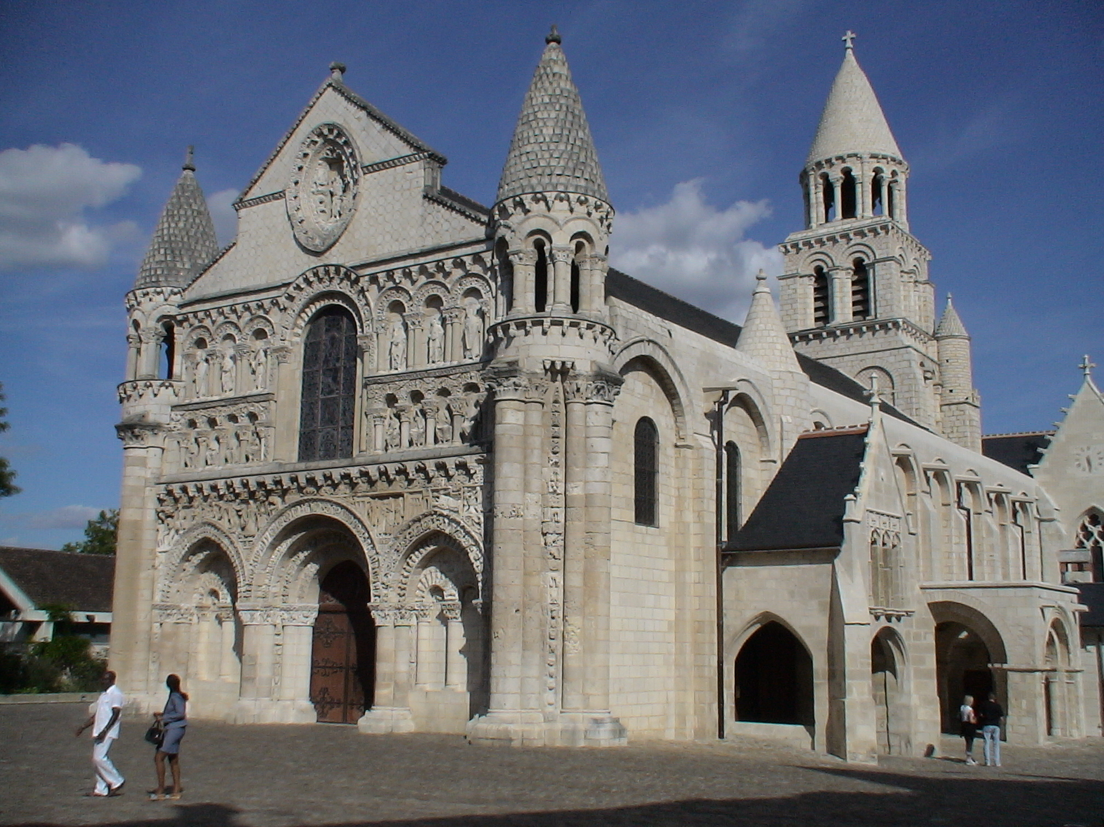
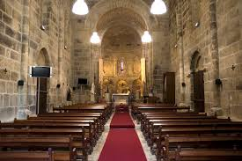
Architecture
Romanesque

Slide 8
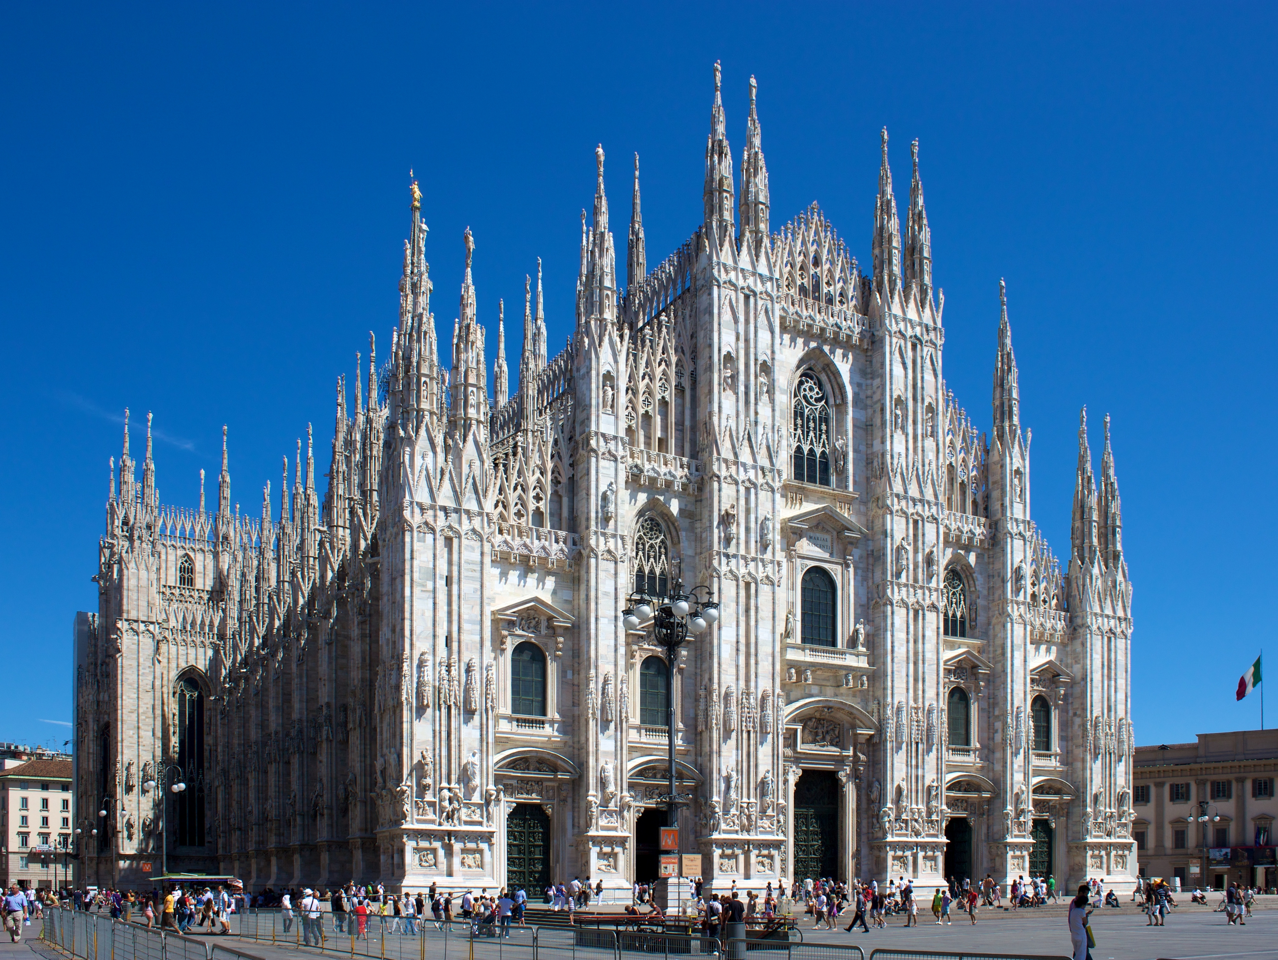
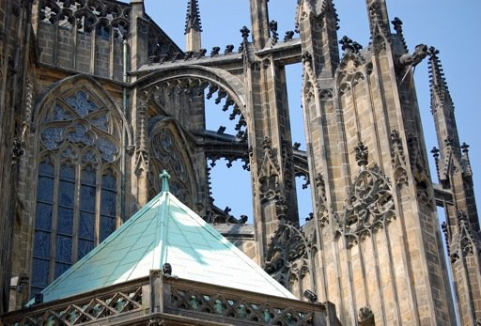
Architecture
Gothic

Slide 9
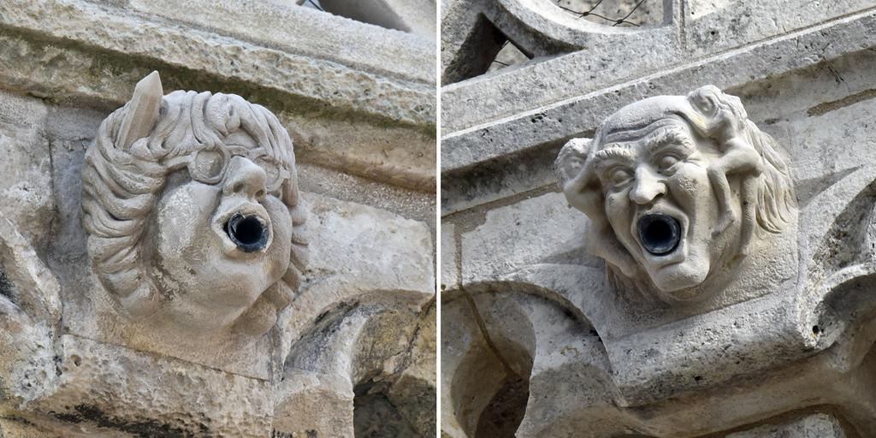
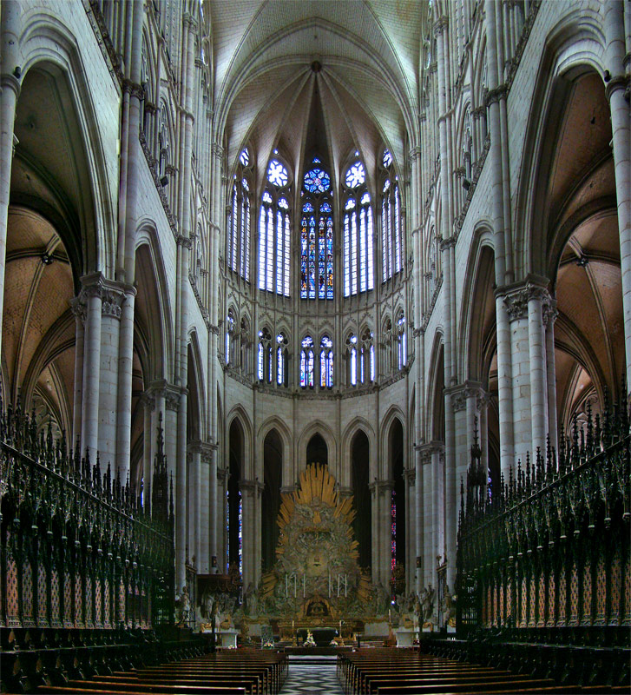
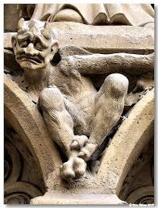
Architecture

Slide 10
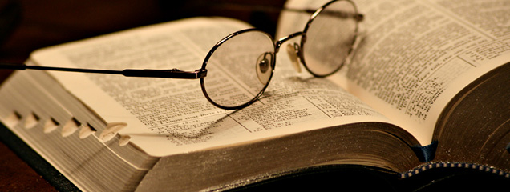
Universities
Theology
St. Thomas Aquinas

Slide 11
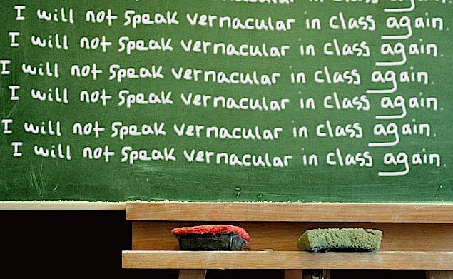
Vernacular

