Slide 1
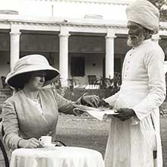
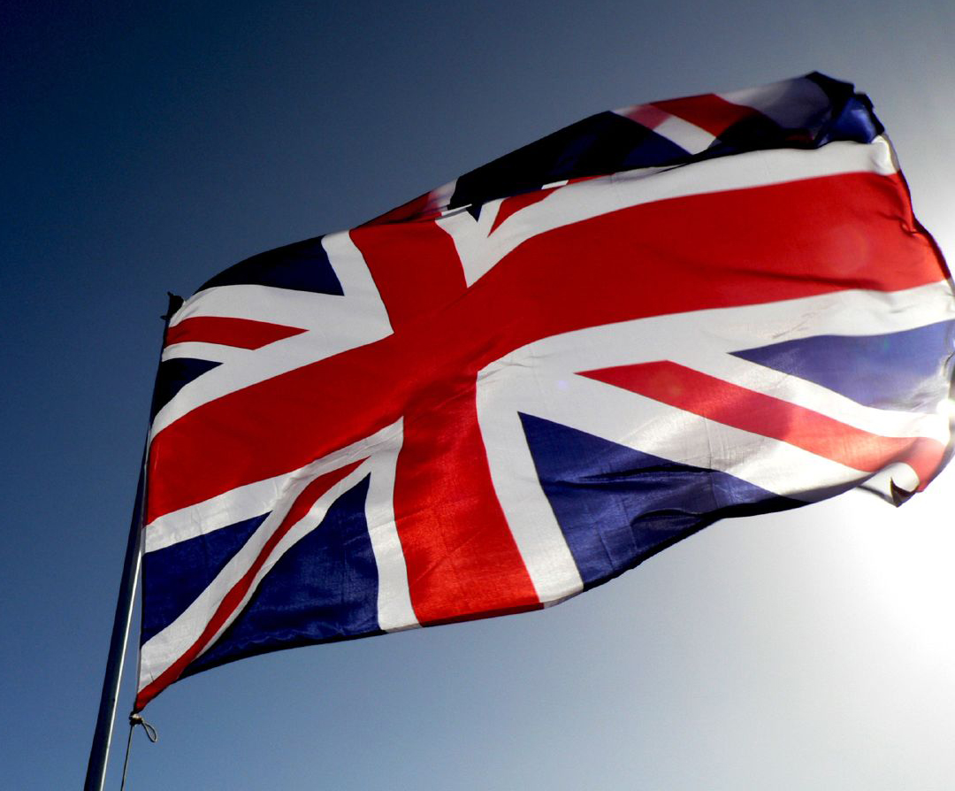
British Rule in India

Slide 2
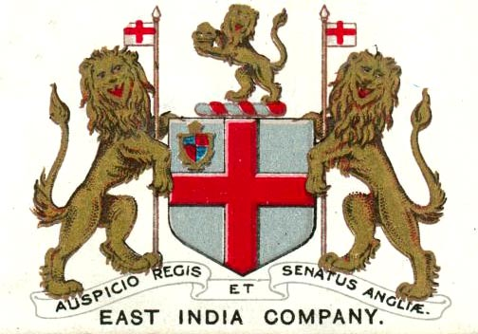
British East Indian Company (BEIC)
Mughal Empire collapses = British companies enter
India = Tea
The BEIC - protect trading ports and interests in India.
Begins to recruit British and Indian troops to protect trade.
By 1857 The BEIC has a military of 280,000 men
Sepoys
BEIC buy and implant local leaders assuming absolute control in India

Slide 3
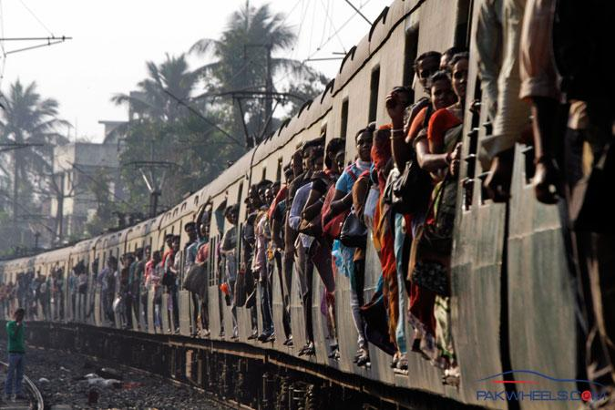
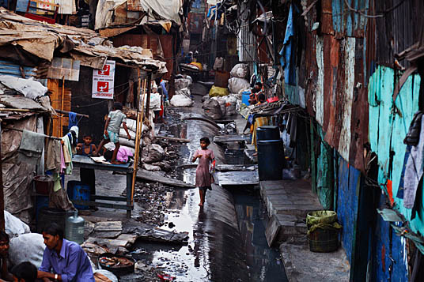
BEIC continued
Missionaries sent to convert population
Good: Schools; Language
Bad: Attempt to show British superiority; Leads to contempt
Rapidly Modernize India
Good: Railroads; Telegraph; Postal Service
Bad: Destroy Indian industries; Tax the population into poverty
India becomes split
Wealthy support the BEIC
Poor oppose the BEIC

Slide 4
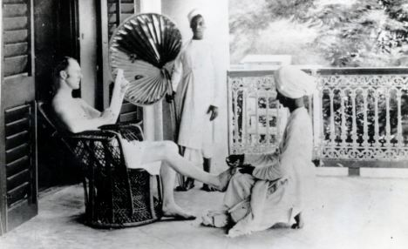
English in India
British merchants could make huge fortunes in India.
In England, a nobleman could make $500/year
A BEIC employee could earn $27,000/year
The risk of moving to India was extreme.
Tropical diseases and heat killed more than ½ of the British within the first two years.
Those who survived became rich and often remained in India adopting the local culture.
British-Indian, not British

Slide 5
Growing Tensions
Many British at home advocated for a respect of the Indian culture and more autonomy.
The BEIC saw the Indians as a conquerable people.
Sepoy Rebellion (1857)
Rumors spread that new rifle cartridges are greased with cow and pig fat. (Untrue)
Troops who protest are imprisoned and degraded.
Leads to rebellion and massacre on both sides.
Sepoy troops shot from cannons

Slide 6
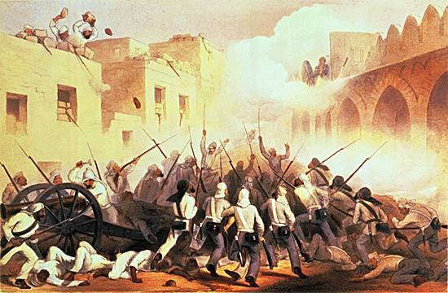
Fall of the BEIC
Debt of the BEIC and the Sepoy Rebellion lead to the British government taking over authority in India.
Queen Victoria becomes the Queen of India
India officially becomes a colony of great Britain

