Slide 1
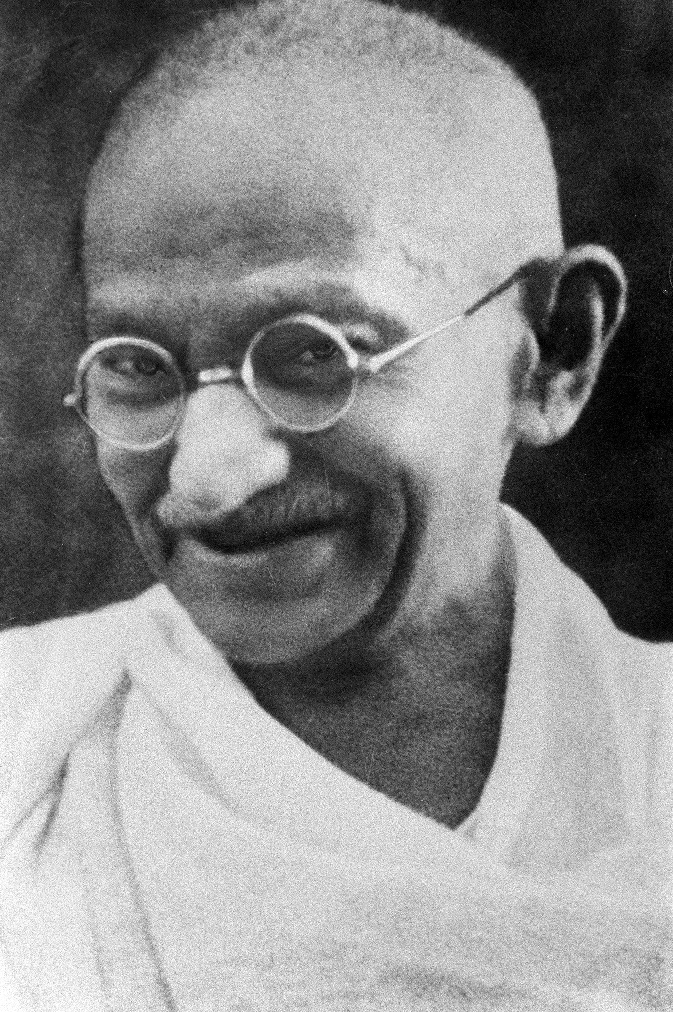
Mohandas Gandhi
1869-1948
Born In India
Law degree in England
1915 Returns to India

Slide 2
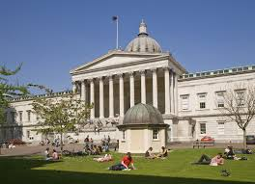
Education
Educated in England
Studied Law

Slide 3
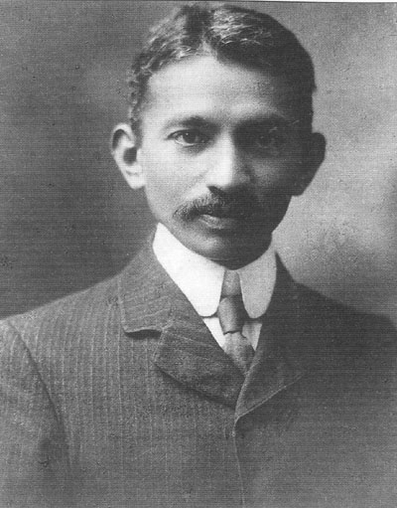
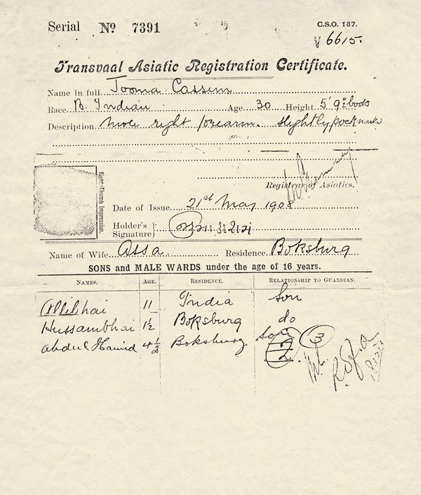
South Africa
Led a resistance against Pass Laws
Required all Indians to carry passes

Slide 4
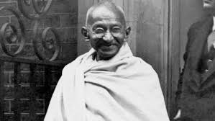
India
Led India in Nonviolent freedom movement
NONVIOLENT
Resistance
Provoke a response
Fasted to prevent his own people from committing violence

Slide 5
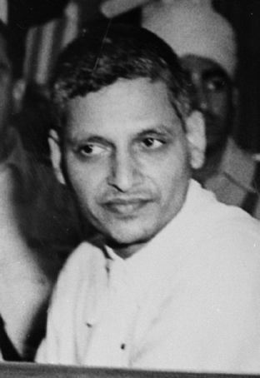
Things to Know
Mahatma – “Great Soul”
Bapu - “Father”
Amritsar Massacre- The massacre of approximately 1000 Indians during a peaceful rally.
Salt March- Symbolic march to make salt in protest of English salt tax
Muhammad Ali Jinnah – First Prime Minister of Pakistan
Jawaharlal Nehru- First Prime Minister of India
Gandhi was assassinated by Nathuram Godse

