Slide 1
Modern India and Pakistan
Chapter 31
Section 2

Slide 2
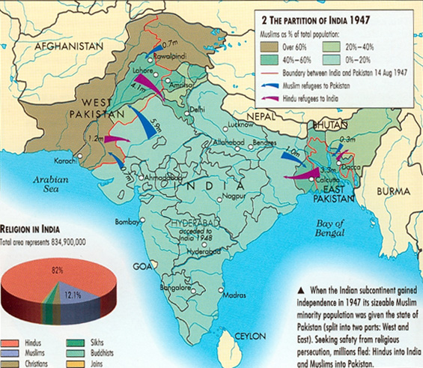
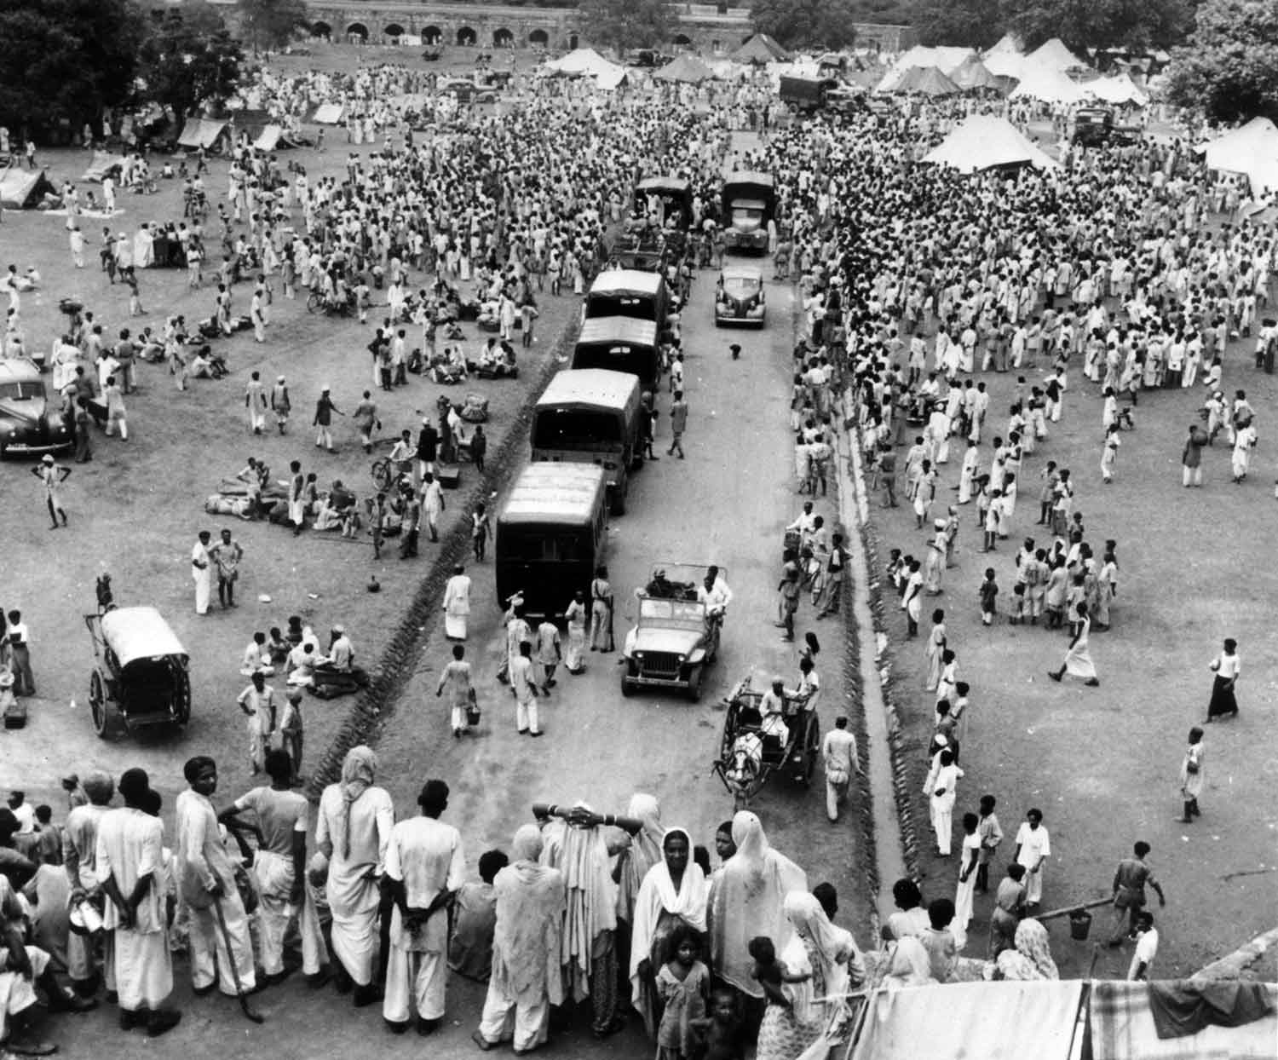
India Pakistan Split

Slide 3
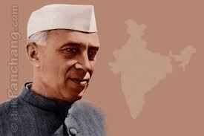
Nehru’s India
Socialist
Nationalized industries, utilities, and transportation
Local privet enterprise and private farms.
Nonalignment
Remain neutral in any military conflict between the United States and USSR

Slide 4
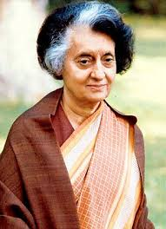
Indira Gandhi
Nehru’s daughter-Not related to Mohandas Gandhi
Prime Minister for most of time between 1966-1984
Used military force against Sikh rebels fighting for independence.
Assassinated by Sikhs in 1984.

Slide 5
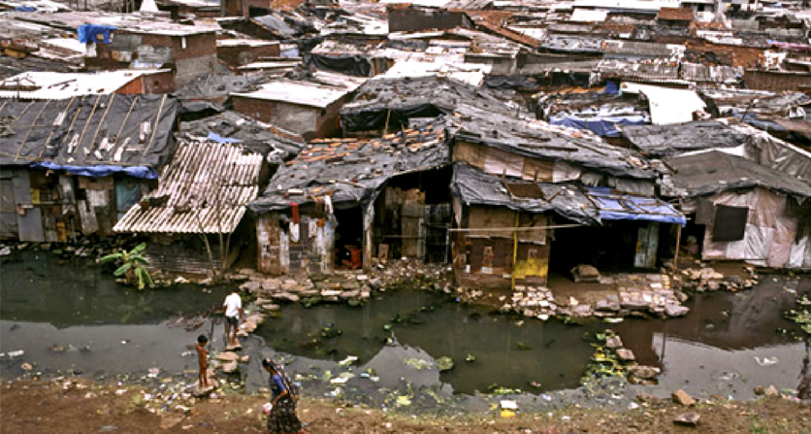
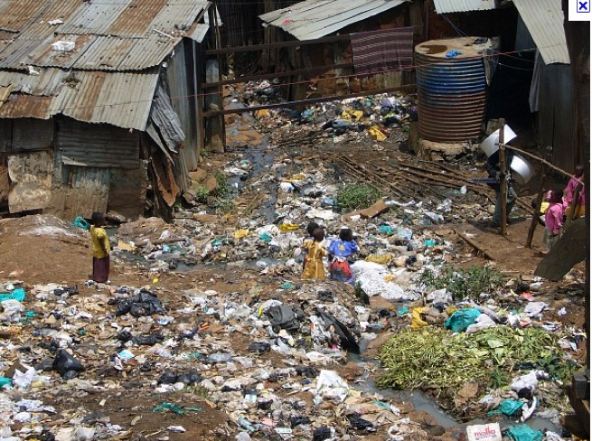
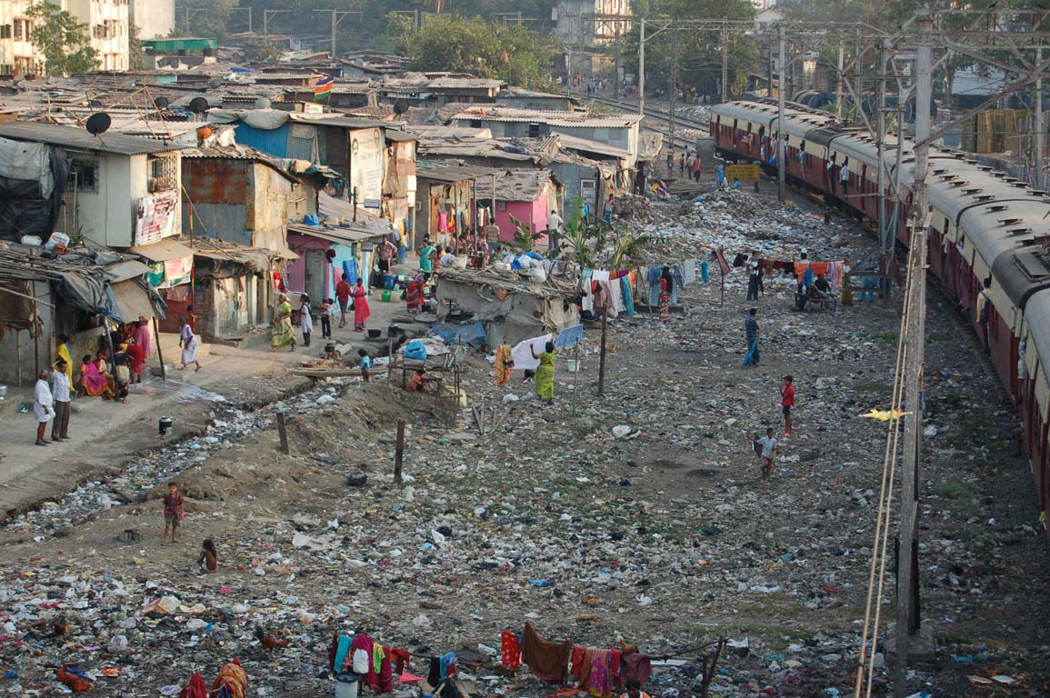
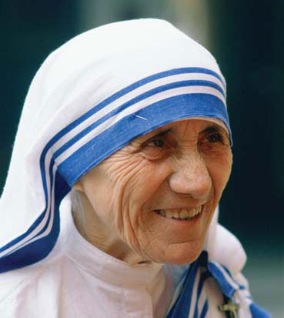
Mother Teresa
Catholic Nun
Attempted to help the poor, sick, and dying in Calcutta.
Helped lead to the country outlawing the idea of “Untouchables”

Slide 6
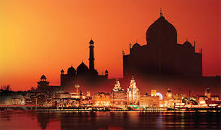
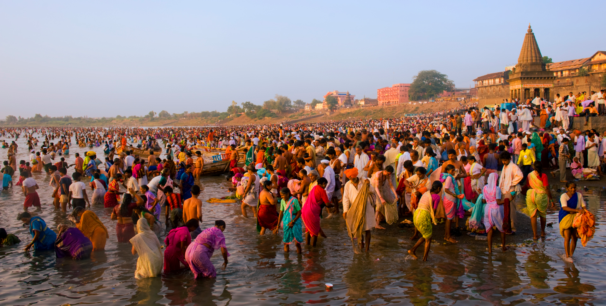
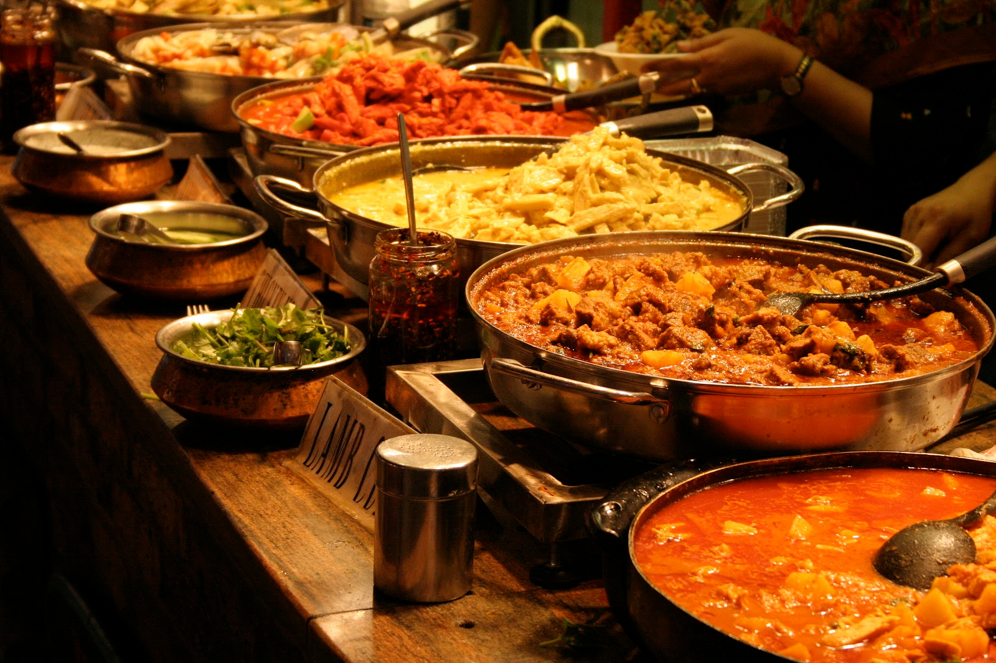
India Today-1,210,193,422 People
Advantages | Disadvantages
One of the worlds largest growing economies – Mixed Economy | Political Corruption
Highly Educated Population | Massive Inequality
Job Opportunities-Outsourcing | Extreme Poverty
Bollywood | Hindu-Islam tensions

Slide 7
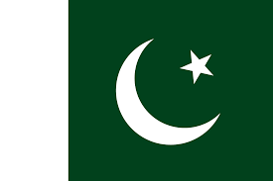
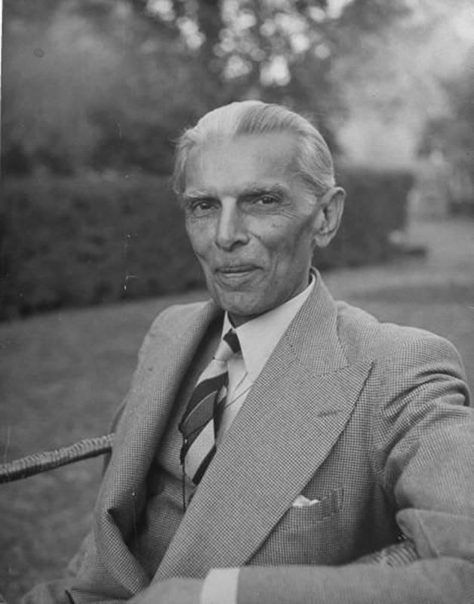
Pakistan
1st Leader: Muhammad Ali Jinnah
Population: 196,174,380
Religion:
97% Muslim
Mostly Sunni
US ALLY???

Slide 8
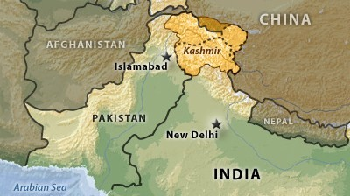
Kashmir
Province in Northern India
Still claimed by both Pakistan and India
Has been the site of many armed conflicts by both revolutionary groups and military troops

Slide 9
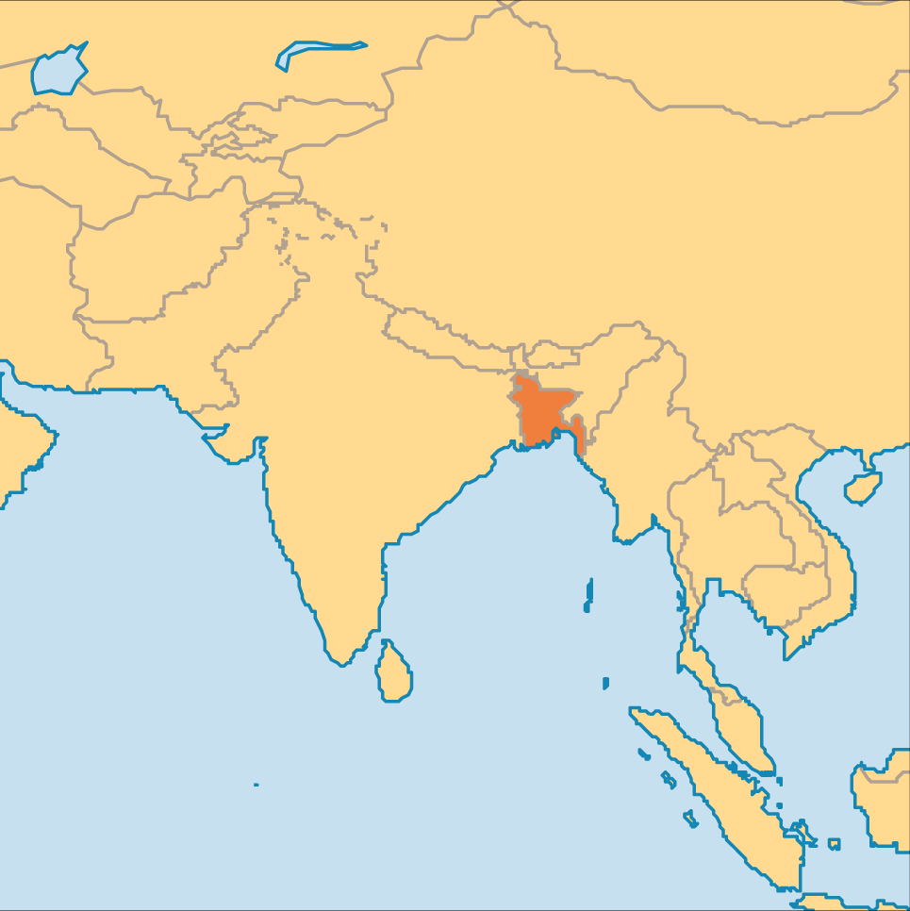
Bangladesh
Initially East Pakistan
With the support of India, declared independence in 1971

