Slide 1
Enlightenment Philosophers
Ch17 Sec 1&2

Slide 2
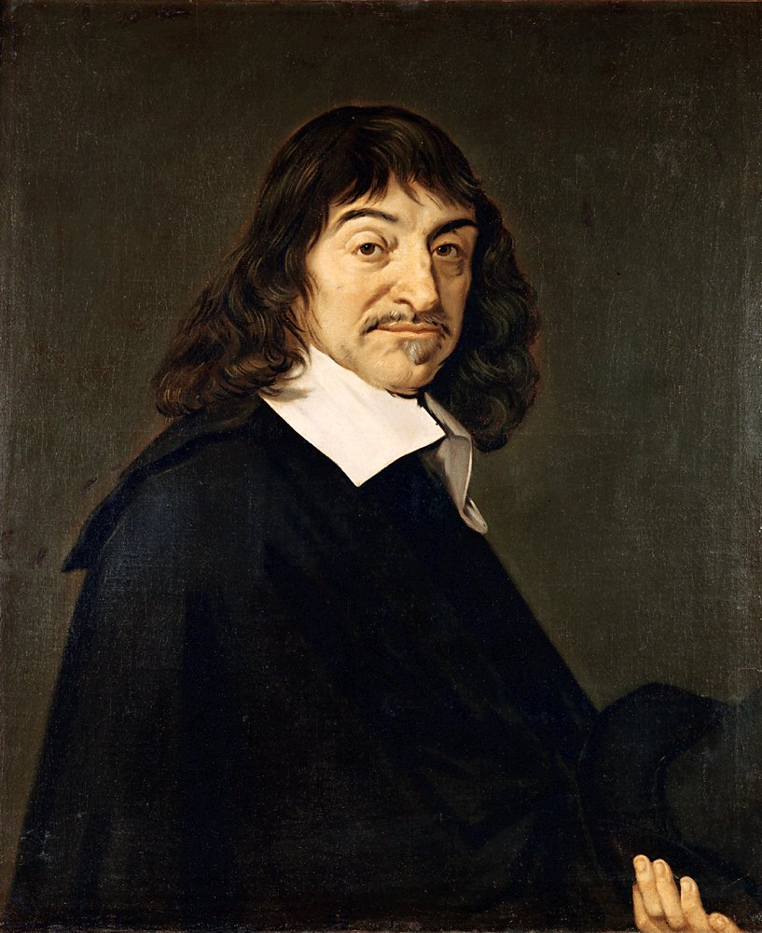
Rene Descartes
Field: French Philosophy and Mathematics
Thought and wrote about doubt and uncertainty in the world
Emphasized importance of his own mind
Only accepted things that his reason said were true
“I think therefore I am:
Father of modern rationalism
Works: Discourse on Method

Slide 3
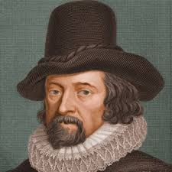
Francis Bacon
Field: English Philosophy and Science
Scientists should use inductive reasoning
Proceed from particular to the general
Free the mind from opinions that may distort the truth.
Created Scientific Method
“That human life be endowed with new discoveries and power”
Works: Scientific Method

Slide 4
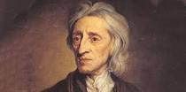
John Locke
Field: English philosophy and politics
Blank Slate theory
People are molded by their experiences
If exposed to correct environment, people would be socially good
Nature vs. Nurture
Governments agree to rule, People agree to be ruled
Works: Two Treaties of Government

Slide 5
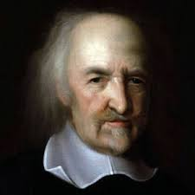
Thomas Hobbs
Field: English philosophy and politics
Claimed that man in a state of nature was “solitary, poor, nasty, and brutish”
To save themselves people form a state
People agree to be ruled
Works: Leviathan

Slide 6
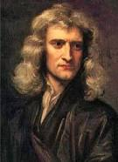
Isaac Newton
Field: Mathematician
Everything in the world operates based on natural laws
Laws should therefore govern human behavior
If institutions followed these natural laws, the result would be an ideal society
Works: None

Slide 7
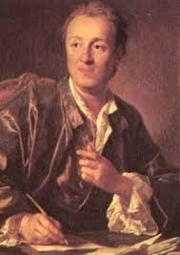
Montesquieu
Field: French Philosopher and Politics
Tried to find the natural laws that govern the social and political relationships of human beings
Government should function through a separation of powers
This would provide the greatest freedom and security to the people
Works: The Spirit of Laws

Slide 8
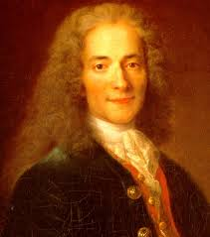
Voltaire
Field: French Philosopher and Metaphysics
Championed deism, religious philosophy based on reason and natural laws
God was a clockmaker setting the universe in motion and let it run without interference
Works: Treaties on Toleration

Slide 9
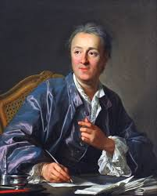
Denis Diderot
Field: French Writer
“Changed the general way of thinking
Created the Encyclopedia
Became a weapon against religious superstition and intolerance
Works: Encyclopedia

Slide 10
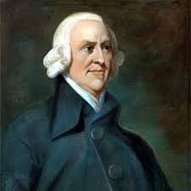
Adam Smith
Field: Scottish Philosophy and Economics
The State should not interrupt the free play of natural economic forces
No regulation on economy
Laissez-Faire
Gov’t has two jobs
Protect citizens and maintain infrastructure
Works: The Wealth of Nations

Slide 11
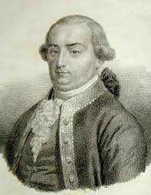
Cesare Beccaria
Field: French Lawyer
Argued punishment should not be excessive in brutality
Opposed capital punishment
“Is it not absurd that the laws, which punish murder, should in order to prevent murder, publicly commit murder themselves?”
Works: On Crimes and Punishment

Slide 12
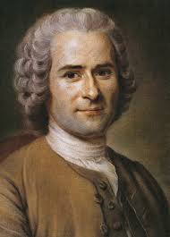
Jean-Jacques Rousseau
Field: French Philosophy and Politics
Argued people created laws and government to protect their private property, but in the process become enslaved by government.
In the social contract the entire society agrees to be governed.
Education should foster and not restrict children's natural instincts.
Works: Discourse on the Origins of the Inequality of Mankind; The Social Contract

Slide 13
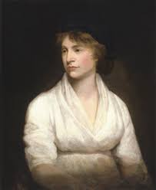
Mary Wollstonecraft
Field: English Writer on Social Needs
Identified two problems with the views of many Enlightenment thinkers
If men demand freedom from monarchs, women should be free from the demands of men
Reason is inherent in all human beings, therefore women are entitled to the same rights as men
Works: Vindication of the Rights of Women

Slide 14
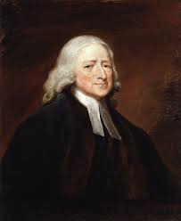
John Wesley
Field: Methodist Preacher
Methodism gave middle and lower class people in England a sense of purpose and community
Stressed the importance of hard work and spiritual contentment rather than demands for political equality
Spiritual existence had not been eliminated by the 18th century search for reason
Works: None

