Slide 1

Middle East Fever Game

Slide 2
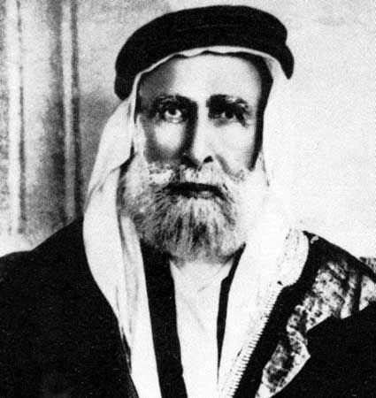
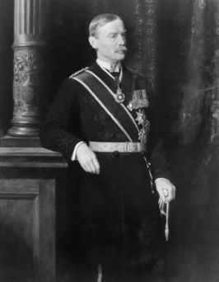
Husayn-McMahon Understanding 1916
Sharif Husayn agreed to fight with Great Britain in WWII with the understanding of a promised Arab homeland following the war.

Slide 3
Husayn-McMahon Understanding 1916

Slide 4
Husayn-McMahon Understanding 1916

Slide 5
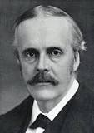
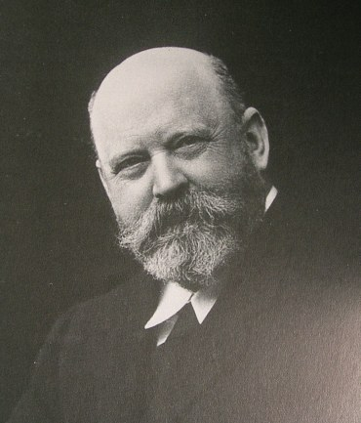
The Balfour declaration 1916
Balfour Declaration
  Agreement between James Balfour (British Parliament) and Walther Rothschild (Influential British Jew)
  A promised to support an Israeli homeland in the Middle East.
    Most of the talks centered around Jerusalem where 56,000 Jews called home
    Jerusalem was also home to 700,000 Arabs

Slide 6
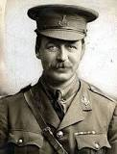
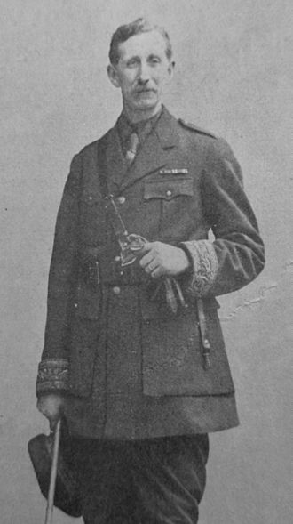
Sykes-Picot Agreement 1916
Agreement made between British politician Mark Sykes and François Georges-Picot.
Stressed the understanding that all countries must take actions that are in the best interest to their nation security (England and France need to do what is best for them)
Agrees to divide most “Advanced Regions” (Iraq, Syria, Lebanon, and Palestine) between French and English Spheres of Influence.

Slide 7
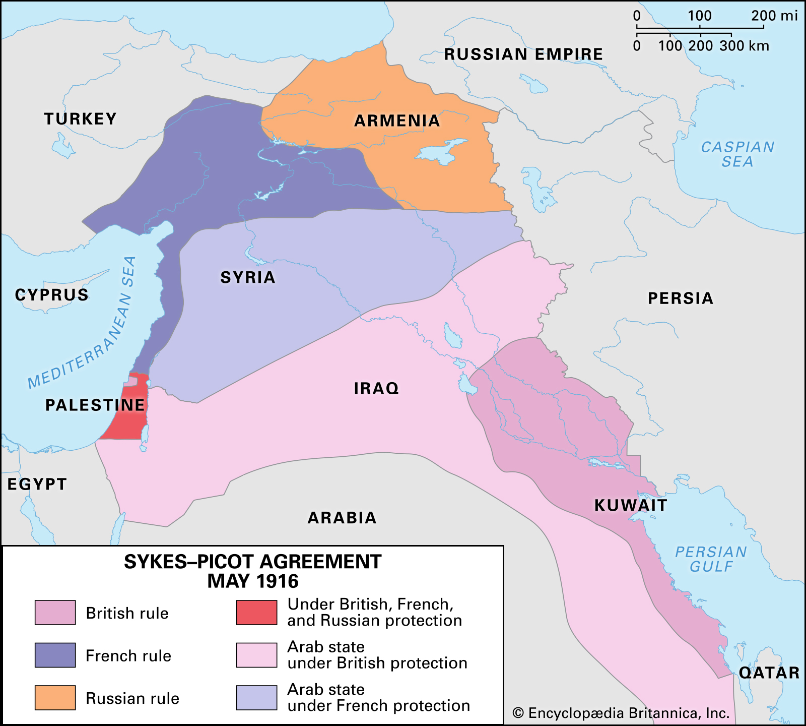
Skyes-Picot Agreement 1916

Slide 8
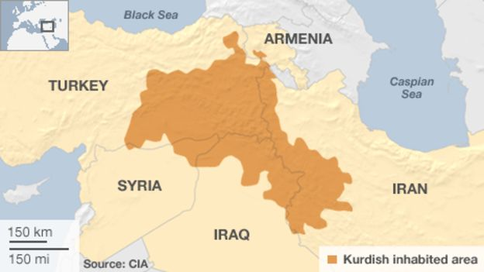
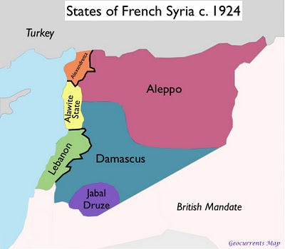
Treaty of Sevres 1920
Treaty signed between Ottoman Empire and Allied Powers of WWI.
Suggests the possibility of an independent Kurdistan
Declares Syria and Lebanon to be officially under French Mandate
  Syrian’s had requested to be members of the new Arab state (Saudi Arabia) or placed under the mandate of the United States. Under no circumstances did they want to remain under French Control.

Slide 9
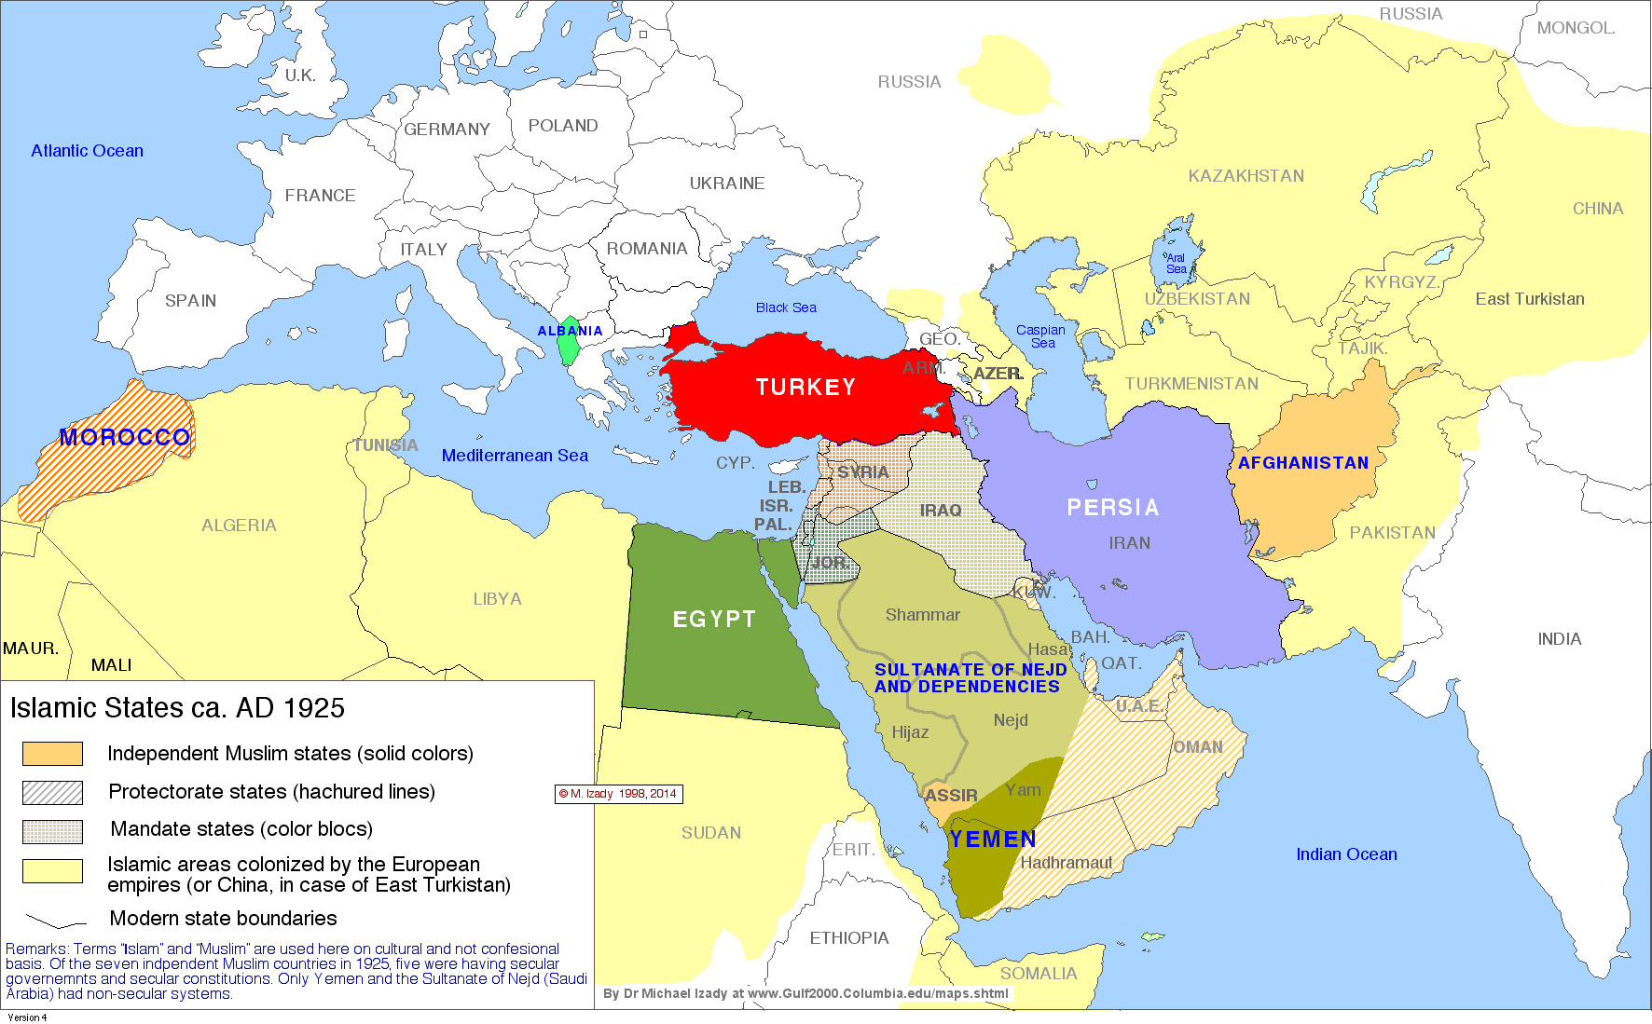
Treaty of Laussane
Grants Turkey freedom and returns much of present day Turkey to the Turks.
Ignores all requests for an independent Kurdistan

