Slide 2
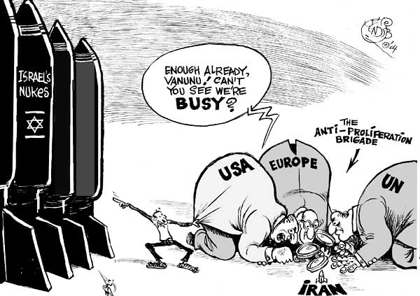
Anger Toward the US
1. Support of Israel

Slide 3
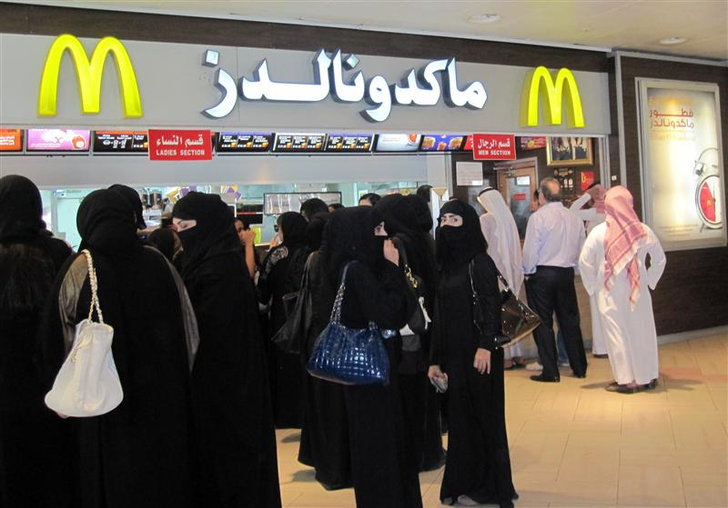
Anger Toward US
Encroachment of Western Values

Slide 4
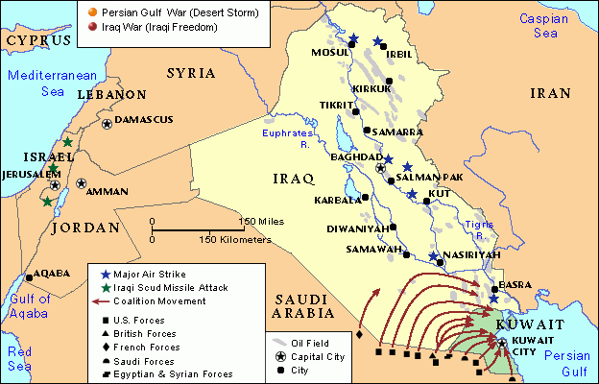
Anger Toward The US
The 1st Iraq War
US agreed to protect Kuwait and Saudi Arabia from Saddam Hussein
Saw US forces stationed in Saudi Arabia as an affront to Islam

Slide 5
Al Qaeda
Osama Bin Laden
9/11

Slide 6
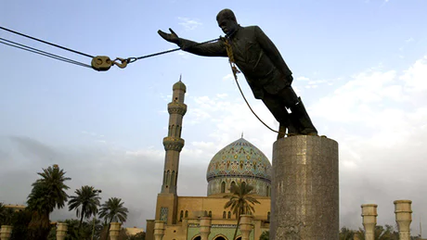
Overthrow of Saddam
Iraq left in disorder
Sunni/Shia conflict resumes

Slide 7
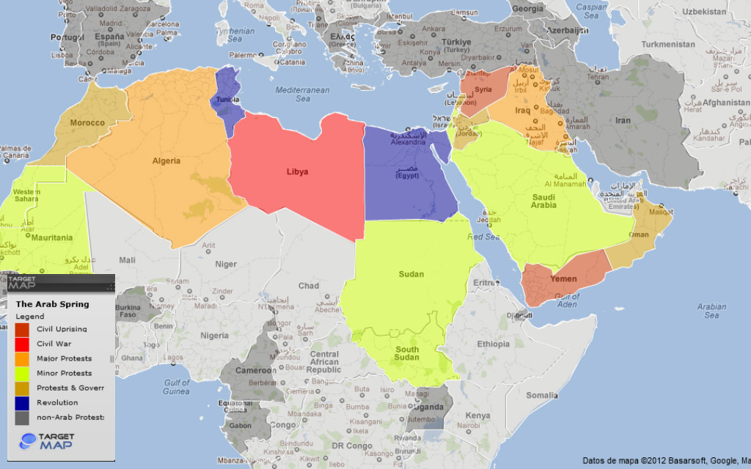
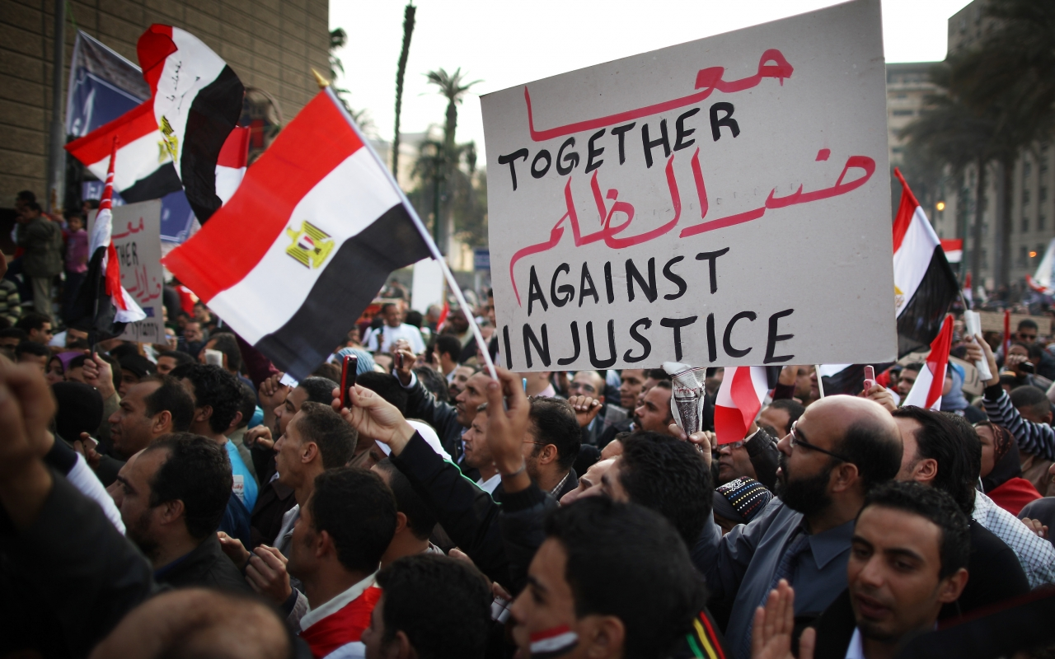
Arab Spring-2010
Tunisia; Egypt; Yemen; Libya Government Overthrown
Jordan; Oman; Sudan; Morocco; Lebanon; – Major Protest and Government Changes
Iraq - Civil War

Slide 8
Syrian Civil War
Bashar al Assad
Supported by Shia Minority
Cracked down on protestors with brutal force

Slide 9
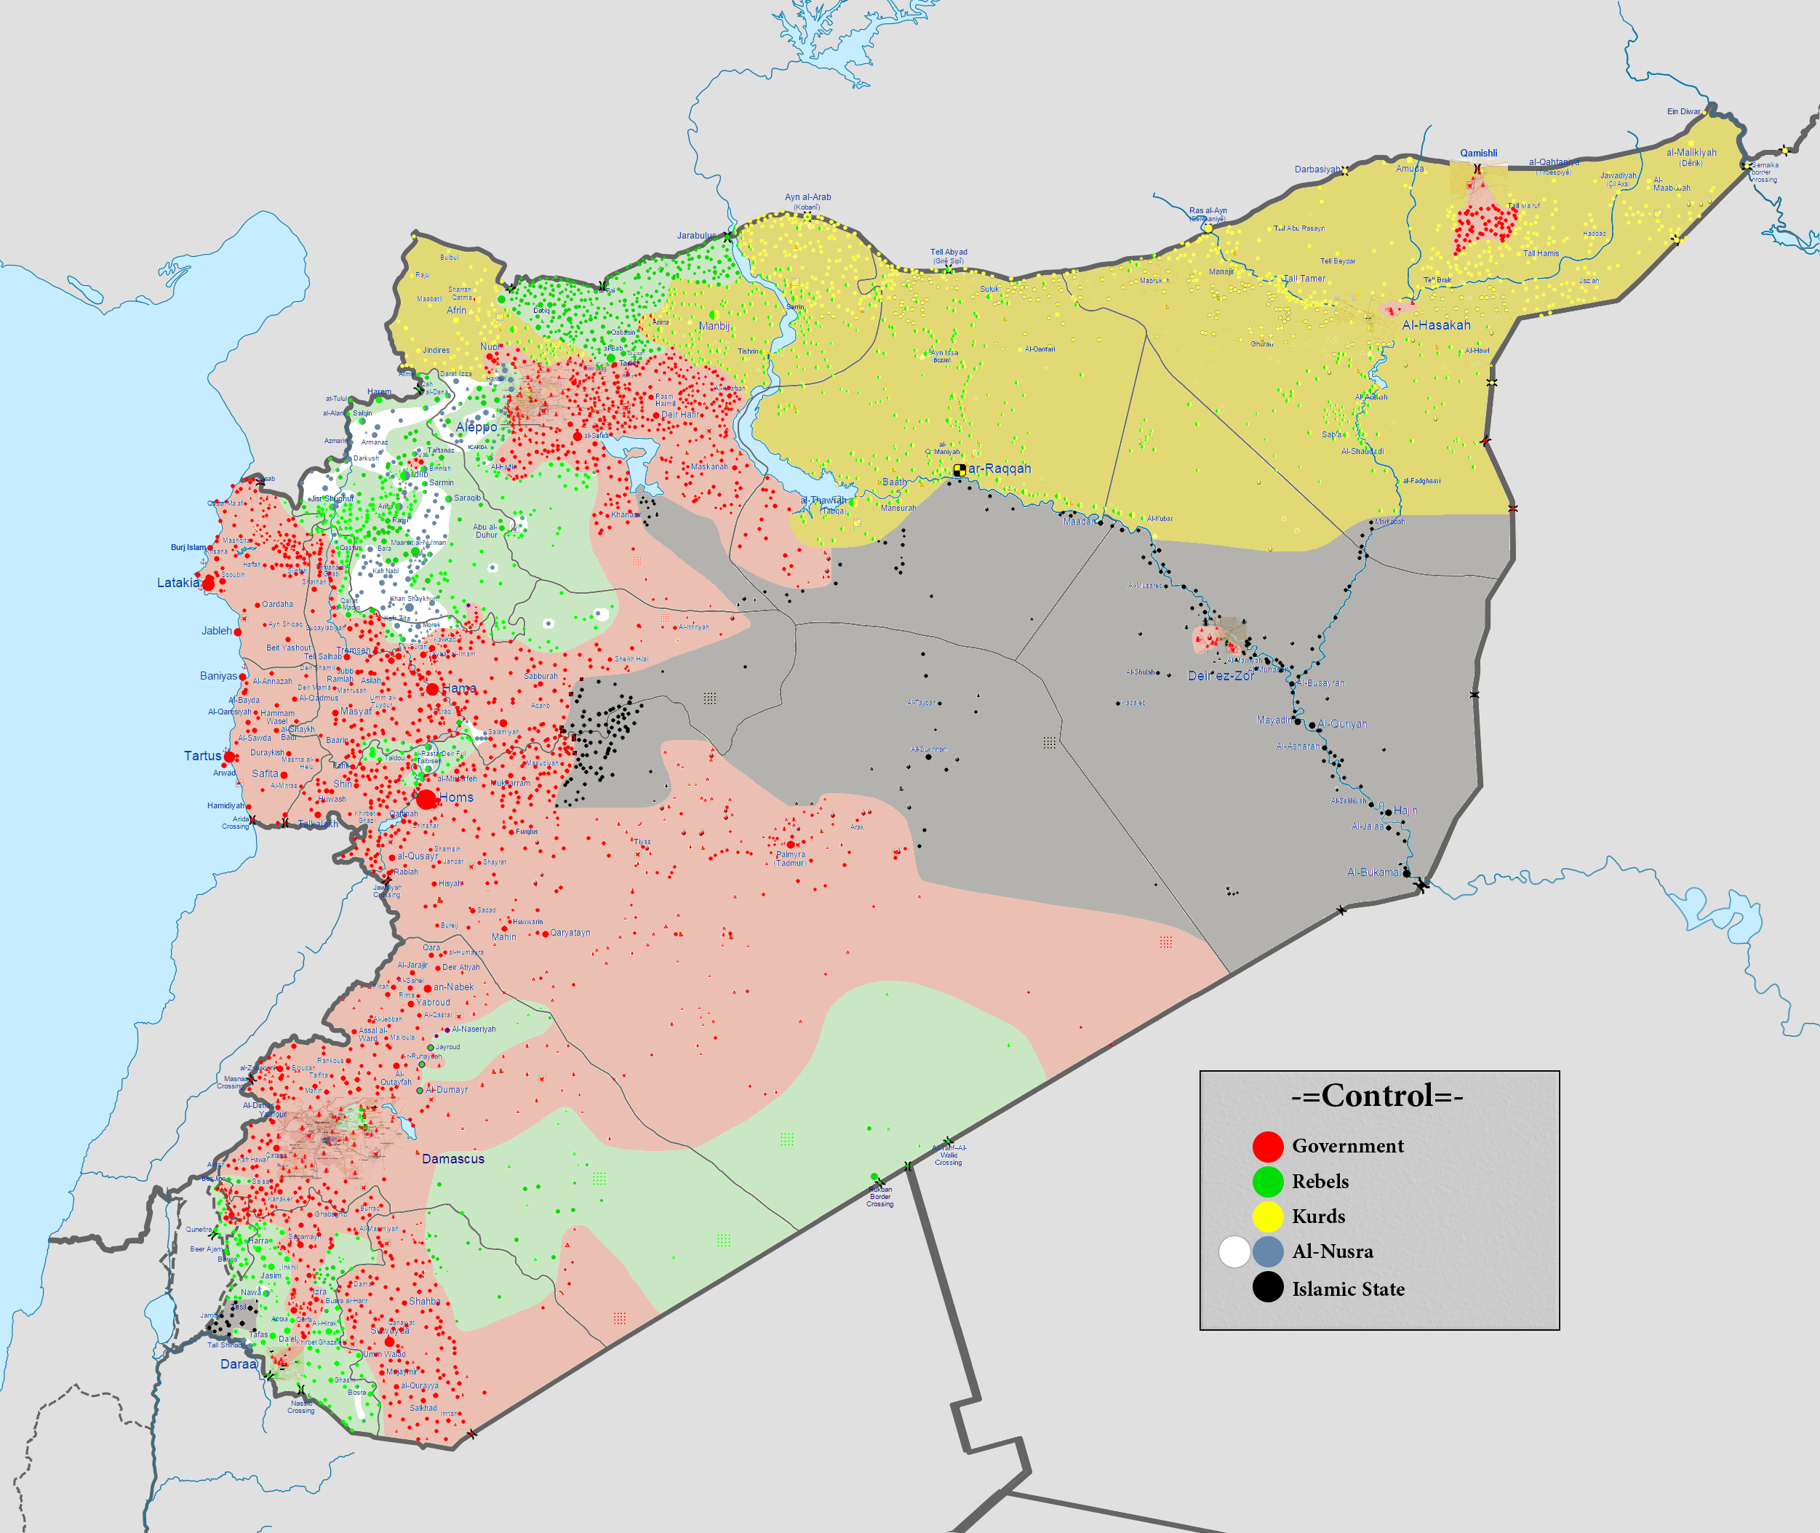

Slide 10
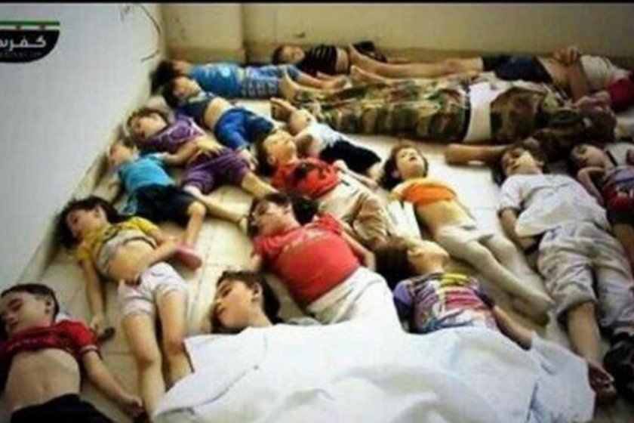
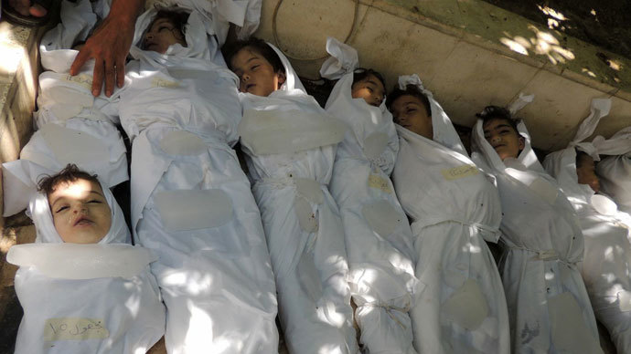
Syrian Gas Attacks 2013 & 2017

Slide 11
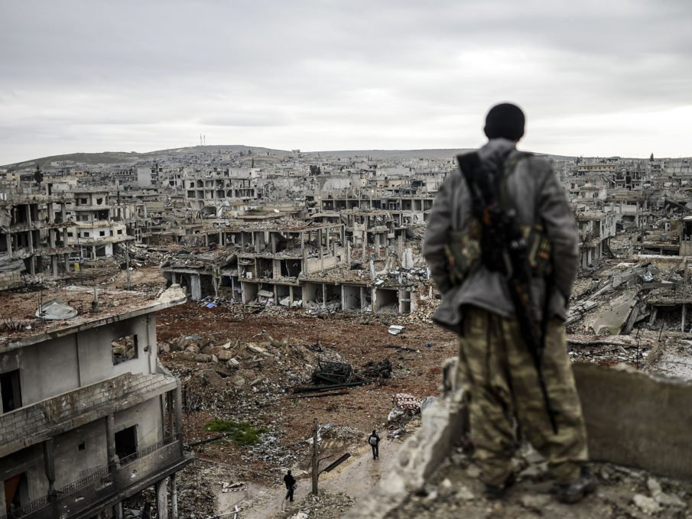

Slide 12
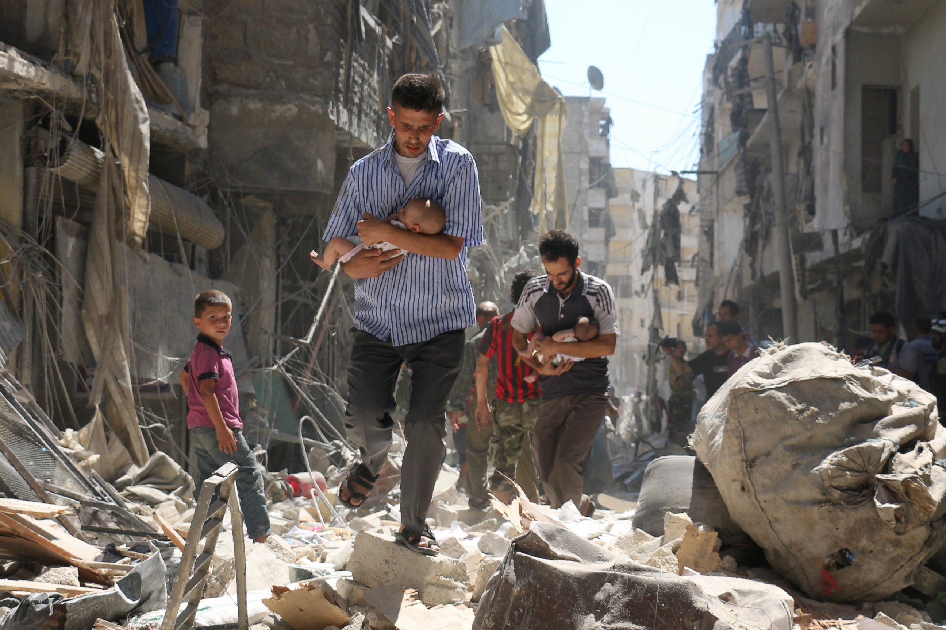

Slide 13
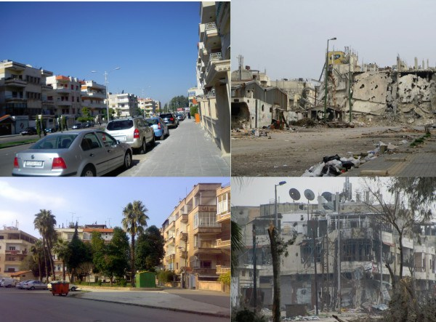

Slide 14
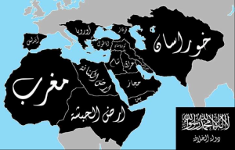
ISIS Goal
Names
Islamic State of Iraq and Syria
Islamic State of Levant
Daesh
Sunni Extremists
Arab Caliphate
Apocalypse

Slide 15
ISIS

Slide 16
