Slide 1
Islam and Muslim Empires

Slide 2
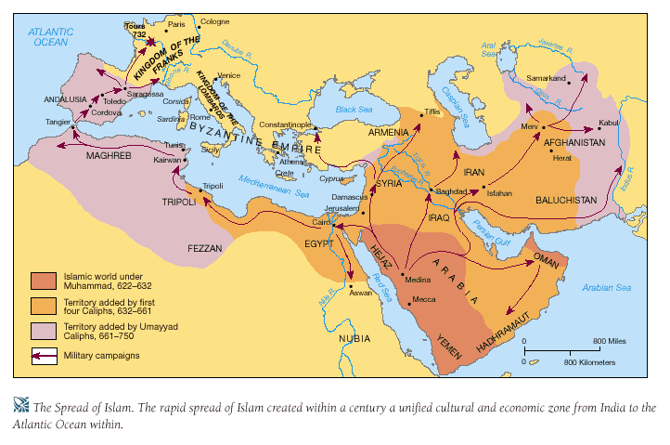
The Death of Muhammad 632ce

Slide 3
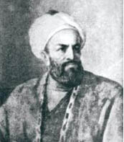
Abu Bakr
1st Caliph
Muhammad’s Father in law
Rules from Madinah
Use Jihad as a justification to spread Islam
Soldiers believed that death in battle granted them their place in paradise

Slide 4
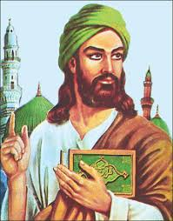
Shia-Sunni Split/Who will Succeed
Abu Bakr’s death leaves no successor
Following two caliphs are assassinated
656ce Ali (Muhammad’s son-in-law) becomes Caliph
The Last Caliph
Assassinated after 5 years

Slide 5
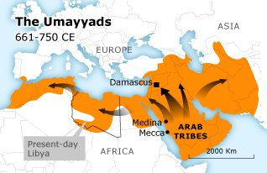
Umayyad Empire 661-750

Slide 6
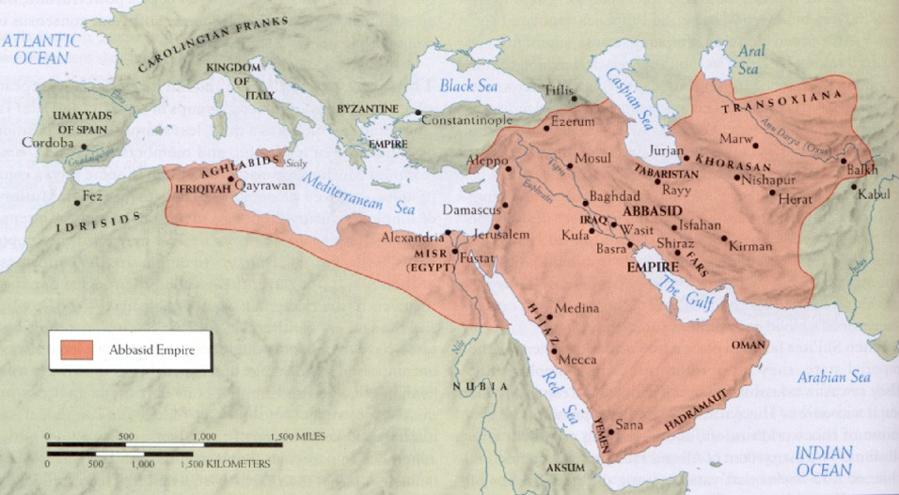
Abbasid Empire 750-1517

Slide 7
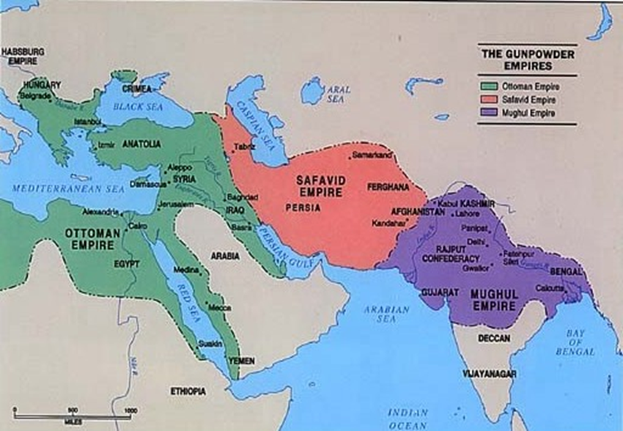
Safavid Empire 1501-1736

Slide 8
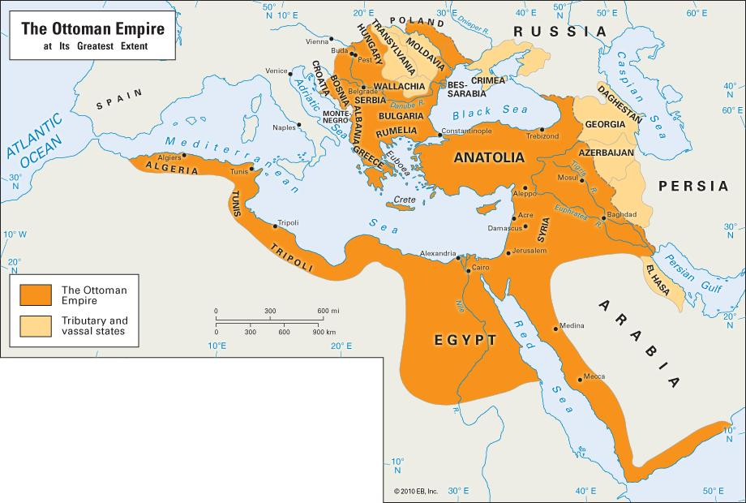
Ottoman Empire 1299-1922

Slide 9
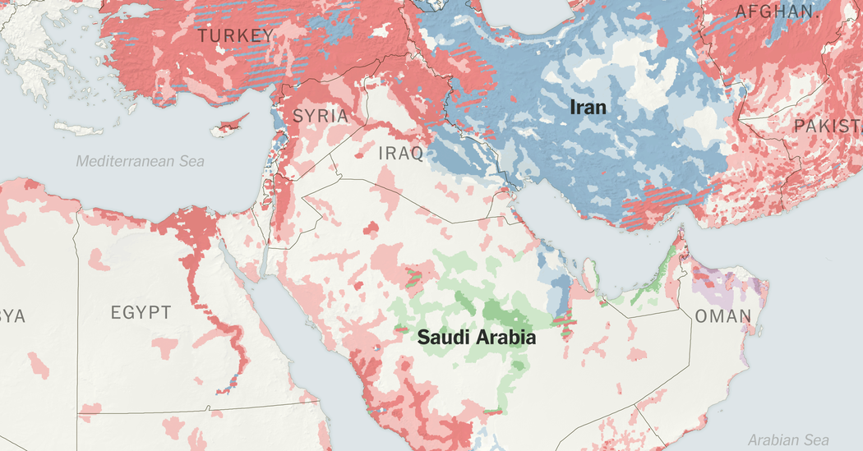
Sunni-Shia Today

