Slide 1
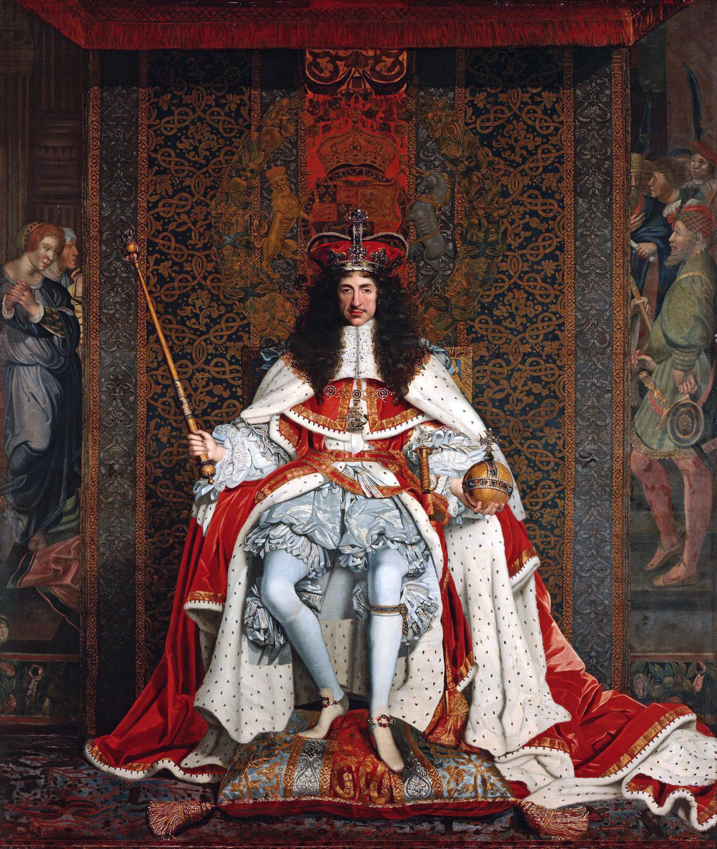
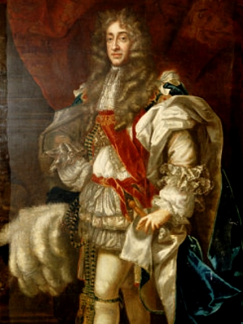
The Second Stuart Dynasty
Revolution in
England

Slide 2
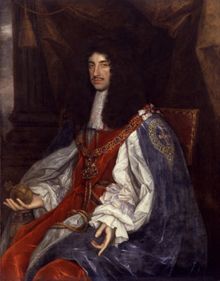
Charles II 1660 - 1685
Charles was invited by Parliament to reestablish the throne.
April 25, 1660 – Declaration of Brenda
Charles agrees to pardon the Crown’s enemies in the English Civil War
May 25, 1660 – Charles executes 9 members of Parliament most responsible for his fathers death and excludes 50 others from Parliament.
Charles allows the new Parliament to oversee the government.

Slide 3
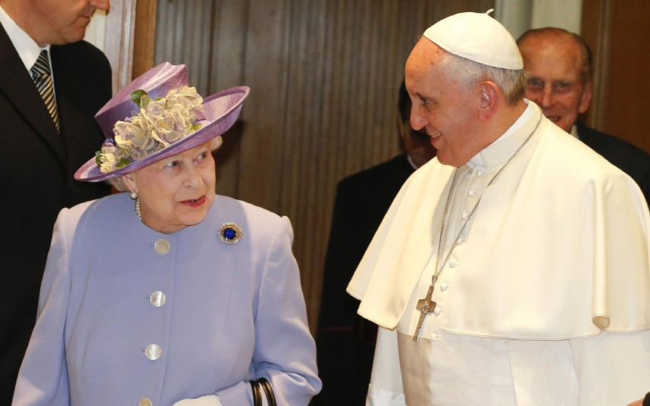
Charles II
Why don’t you make like a tree and LEAF!
1670- Treaty of Dover
In need of money, Charles promises to help France with their protestant problem
Charles also promises to covert to Catholicism
After 4 miscarriages, Charles has no hopes to conceive an heir. His brother James, a devout Catholic is next in line to the throne.
1673 – Parliament passes the Test Act.
All members of government must receive publically receive communion in an Anglican Church.
Anyone refusing to can not hold office. Including the King.

Slide 4
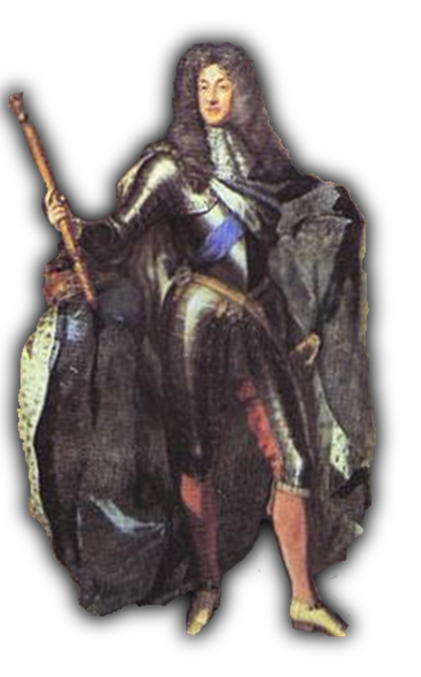
James II 1685 - 1688
James is a very staunch Catholic
Appoints Catholics to high positions of power in the government and army.
Arrests protestants in the House of Commons
Attacks English liberty and challenging social privileges of the nobility.

Slide 5
James II
James becomes king at the age of 52 (Life Expectancy was 35 years)
Two Children from his 1st marriage: Mary and Anne (Both Protestant)
In 1688, James 2nd wife (Catholic) bears a son.

Slide 6
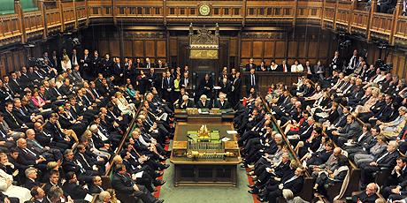
Glorious Revolution
Within days, Parliament has sent letters to James’ daughter Mary and her husband William of Orange requesting them to invade England.
The Revolution of 1688
The Bloodless Revolution
Whigs (William) vs. Tories (James)
James looked for aid from the French which never arrived.

Slide 7
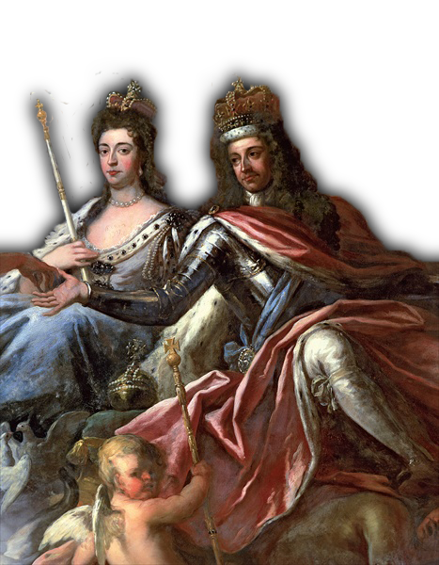
Glorious Revolution
William of Orange and Mary II become the only King and Queen of England
William and Mary agree to rule with parliaments consent. England has become a Constitutional Monarchy

Slide 8
English Bill of Rights
Parliament will make laws and sets taxes
Monarchy had to rule with Parliament (Parliament was supreme)
Right to bear arms
Right to Trial by Jury
Freely elected Parliament
Toleration Act of 1689—granted Puritans (Later Catholics) freedom of public worship

